Slide 1
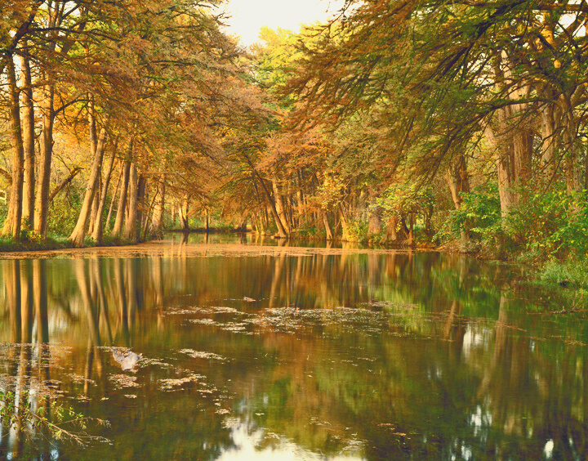
TEXAS LIVING WATERS PROJECT
2020 Texas Water Conservation Scorecard
Speakers: Jennifer Walker, Ken Kramer and Meghan Bock
June 30, 2020
Notes:
Speaker: JW
Welcome to the Texas Water Conservation Scorecard Webinar. We are excited to have so many people join us this morning.
For today’s webinar we are going to focus on the methodology that we used to produce the Scorecard and results that we have found. We hope that you have had a chance to check out the scorecard online already. If not, you will have a deeper understanding of our approach and what goes into your utilities score at the end of this presentation.

Slide 2
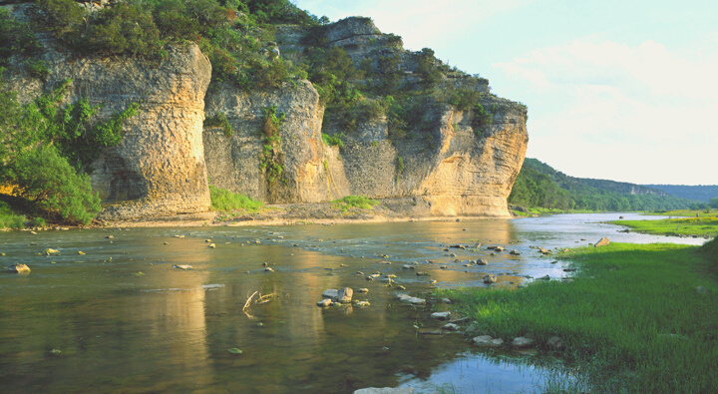
AGENDA
Logistics and Introduction
About Texas Living Waters
Introduction
Methodology
Key Findings
Recommendations
Questions and Comments
Notes:
Speaker: JW

Slide 3
Speaker: JW
Logistics
Webinar will be 60 minutes with time for Q&A at the end
Audio through your telephone or computer, microphone & speakers
Please Submit questions through the Q&A function, they will be answered at the end of the webinar by the presenters.
All participants will be muted
Webinar recording and slides will be posted online
Notes:
Speaker: JW
You all are probably pretty used to Zoom by now but here are a few logistics…
Webinar will be 60 minutes with time for Q&A at end.
If you have questions, please submit them through the Q&A function at the bottom center of your screen. Teal will be monitoring these and queuing them and we will address them at the end of the presentation.
This webinar is being recorded. A recording and the slides will be posted online @ texaslivingwaters.org

Slide 4
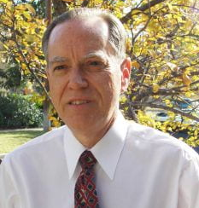
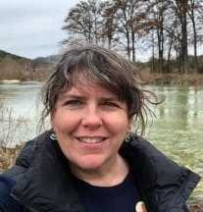
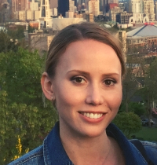
PRESENTERS
JENNIFER WALKER
National Wildlife Federation
KEN KRAMER
Sierra Club
MEGHAN BOCK
Aiqueous
Notes:
Speaker: JW
Let me introduce you to our speakers today:
Ken Kramer is the Water Resources Chair for the Lone Star Chapter of the Sierra Club
Jennifer Walker is the Deputy Director for the Texas Coast and Water Program at National Wildlife Federation
Meghan Bock is a Senior Analyst at Aiqueous.
Behind the scenes we have Teal Harrison, Shell Rumohr, and Sapna Mulki helping out making sure your questions are getting queued up and answered and that things are running smoothly.

Slide 5
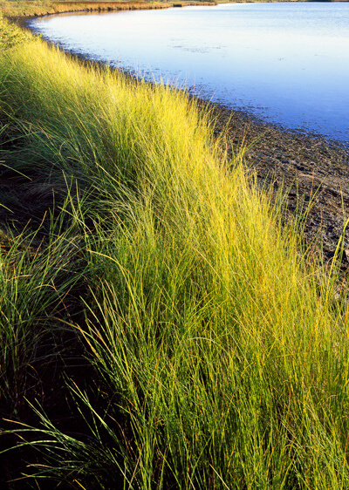
ACKNOWLEDGEMENTS
2020 Texas Water Conservation Scorecard
Produced with generous support from the
The Meadows Foundation
Special thanks to the
Texas Water Development Board &
Texas Commission on Environmental Quality
Notes:
Speaker: JW
We had a great team working to produce the Texas Water Conservation Scorecard, but we didn’t do it alone.
The production of the 2020 Texas Water Conservation Scorecard was made possible through the generous support of the The Meadows Foundation. Thank you to the Meadows Foundation for your support for this project!
We would also like to acknowledge the staff at the Texas Water Development Board and Texas Commission on Environmental Quality for their patience with our numerous inquiries and requests for public documents. You all are very patient and we appreciate you.

Slide 6
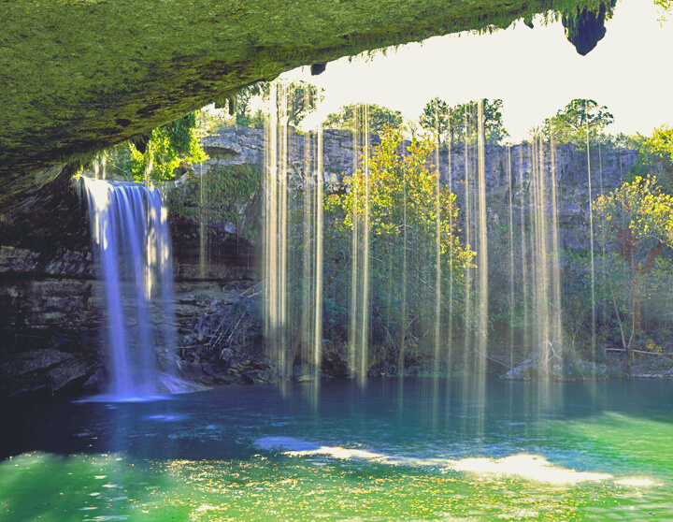
Texas Living Waters Project
We are a collaboration of conservation groups working to ensure fresh water will always reach its natural destinations. For our wildlife, our economy and our kids.
Notes:
Speaker: JW
The Texas Living Waters Project is a collaboration of 4 conservation groups. They are National Wildlife Federation, The Lone Star Chapter of the Sierra Club, Galveston Bay Foundation and Hill Country Alliance. We are working together to ensure that we have water in the future for thriving communities and abundant fish and wildlife habitat. We have 3 major programmatic areas that we focus on: Water for Wildlife, Climate Resilience and Urban Water Management. You may be asking yourself what urban water management has to do with fish and wildlife protection and the answer is they are strongly connected. How we plan for and manage water to meet urban water supply needs impacts the environment. We will not be able to meet the water needs of all Texans, this includes both people and the environment, unless we do all we can to use water efficiently in our communities. We offer the Texas Water Conservation Scorecard to help inspire and educate utilities in that effort.

Slide 7
Texas Water Conservation Scorecard
TWCS is an in-depth analysis and ranking of water conservation efforts of more than 350 water utilities in Texas.
The Scorecard is an evaluation of utilities based largely on the level of effort to advance water conservation rather than the utility’s performance in achieving conservation.
INTRODUCTION
Texas Living Waters Project
Notes:
Speaker: JW
The Texas Water Conservation Scorecard is an in-depth analysis and ranking of the water conservation efforts of 356 Texas public water utilities.
We are evaluating utilities largely on their level of effort.

Slide 8
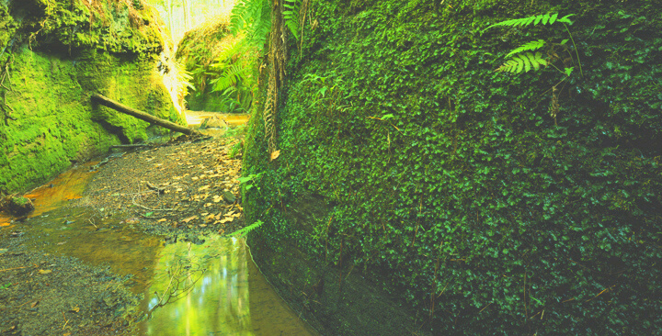
THE SCORECARD IS BASED ON PUBLICLY AVAILABLE INFORMATION
THE SCORECARD PROVIDES ADDITIONAL INFORMATION FOR THE STATE’S 40 LARGEST WATER UTILITIES
Notes:
Speaker: JW
Jen segues into methodology slides and Meghan

Slide 9
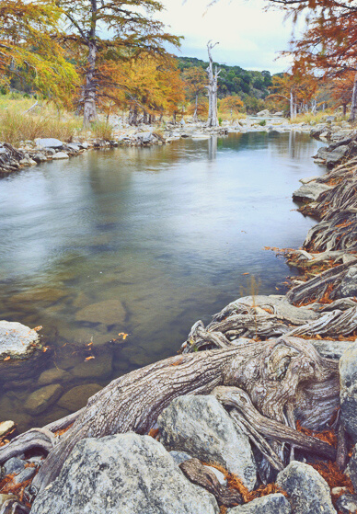
Methodology
Utilities with 3,300 connections or more.
Large and medium utilities (25,000+ customers) are evaluated on 10 metrics with a total 100 possible points.
Small utilities (<25,000 customers) are rated on 6 metrics with a total of 55 possible points.
Notes:
Speaker: MB

Slide 10
Methodology: Criteria
Compliance with water conservation planning
Setting strong water conservation goals
Compliance with reporting requirements
Mandatory outdoor watering limitations
Presentations are communication tools that can be demonstrations, lectures, and speeches.
Meeting targets for water use reduction
Rate-based incentives for efficient use of water
Presentations are communication tools that can be demonstrations, lectures, and speeches.
Notes:
Speaker: MB

Slide 11
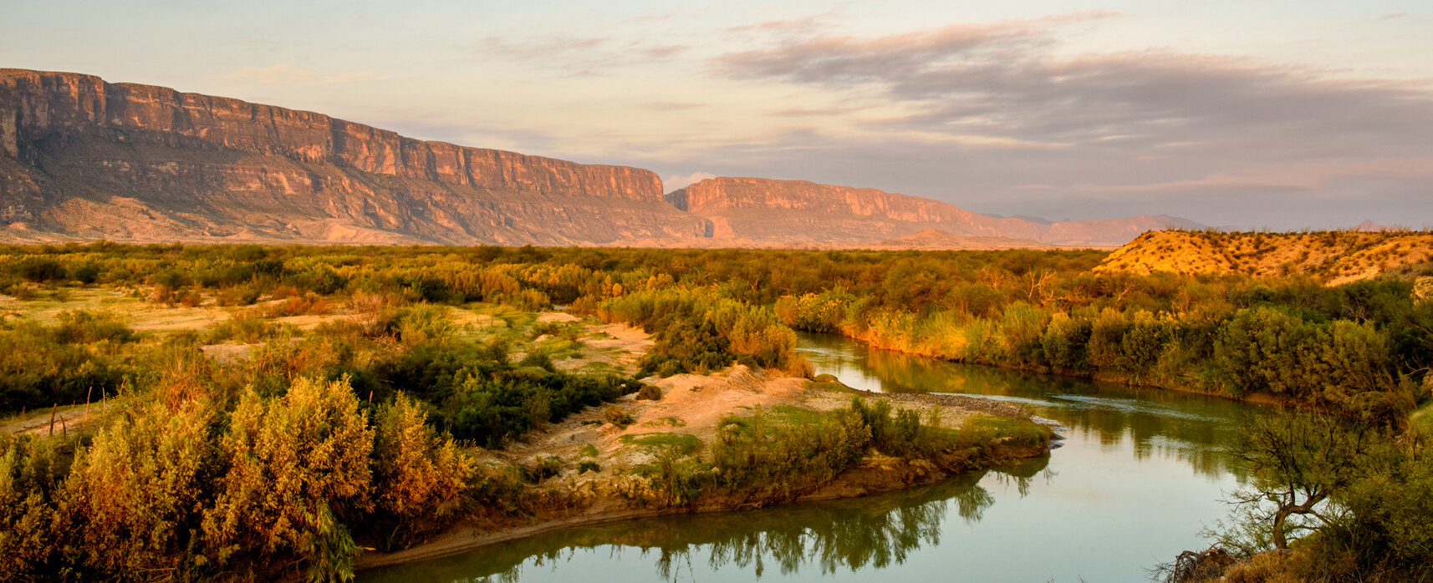
Limitations
LACK OF REPORTING
INCONSISTENT REPORTING
If a utility did not submit
required plans and reports to State water officials, then a utility not only
failed to receive points
Wide disparity in the
usefulness, cohesiveness, and even accuracy of information provided in reports.
TIMING & NATURE OF REPORTING
There is a lag time between submittal of certain reports and the availability of the data in those reports.
Notes:
Speaker: MB

Slide 12
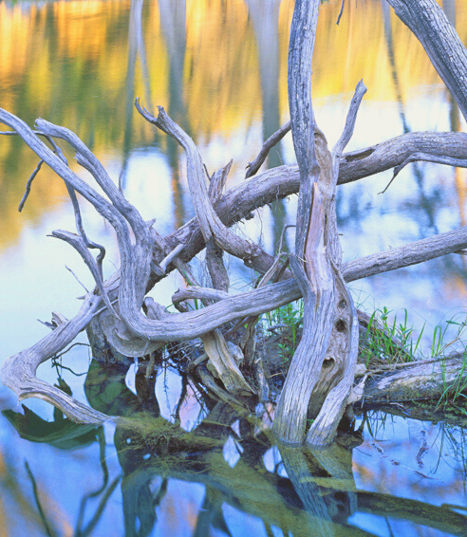
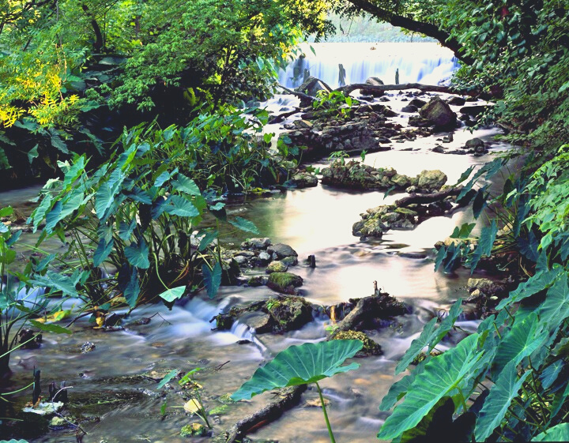
KEY FINDINGS
Notes:
Speaker: MB
Meghan segways to Jen

Slide 13
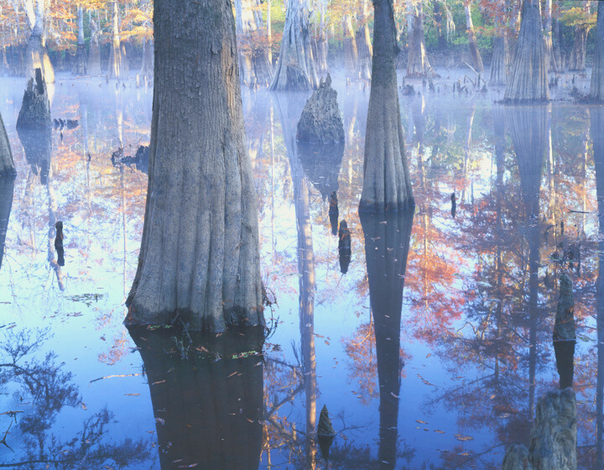
THE TOTAL NUMBER OF WATER UTILITIES SUBMITTING
5-YEAR WCP HAS DECREASED SLIGHTLY
REPORTING:
Water Conservation Plans
In 2016, approximately 91% of utilities submitted Water Conservation Plans.
In 2020, approximately 93% of utilities submitted a Water Conservation Plan.
Notes:
Speaker: JW
One of our key metrics is whether or not a utility submitted a their Water Conservation Plan. This plan is required to be submitted every 5 years. The most recent plan was due on May 2019 and utilities received 5 points if they submitted their WCP. The submittal rate for WCPs and basically unchanged when comparing the 2016 scorecard to the 2020 scorecard.
Water Conservation Plans are important. This is where water utilities lay our their water conservation goals for the next 5 and 10 years and where they describe the programs that they will implement to meet those goals. We use the data reported in these plans to look at several of the metrics in the water conservation scorecard.

Slide 14
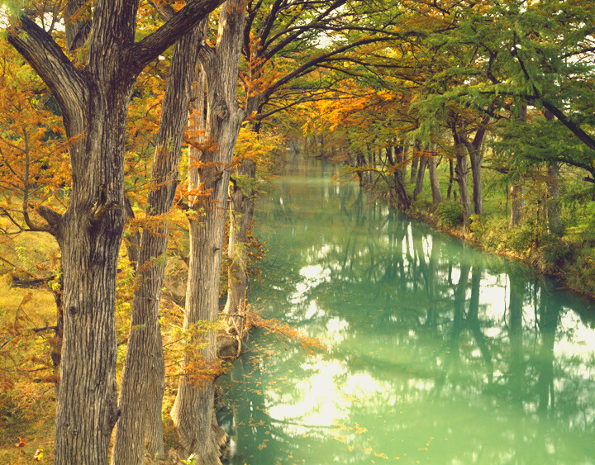
REPORTING:
THE PERCENTAGE OF UTILITIES SUBMITTING ANNUAL
REPORTS IS ABOUT THE SAME
Annual Implementation Reports
In 2016, about 83% submitted an Annual Report.
In 2020, about 82% submitted an Annual Report
Notes:
Speaker: JW
Utilities with 3300 connections or more are required to submit Water Conservation Implementation Reports annually. About 20% of the 356 utilities that we evaluated for the 2020 scorecard did not submit their required annual reports.
The purpose of an Annual Report is to evaluate an entity’s progress in implementing programs to achieve their water conservation targets and goals. The data in this report can be helpful in tracking the efficacy of water conservation programs on an annual basis and, thus, useful for evaluating program successes and needs.
47 percent of all Texas utilities have submitted a water conservation implementation report every year since the Scorecard began in 2016
Utilities that submit their reports received 5 points on the scorecard.

Slide 15
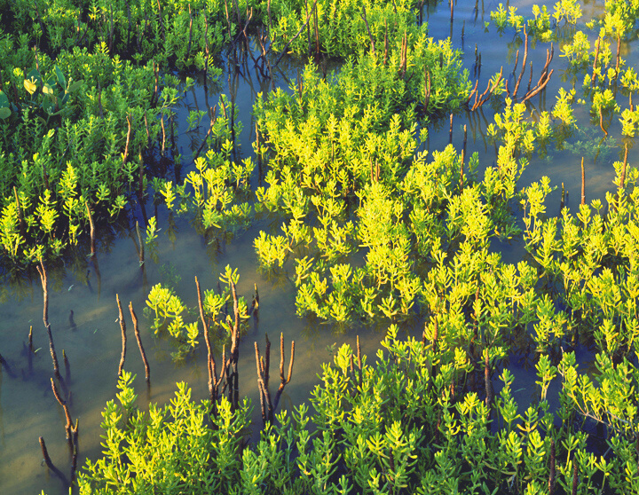
REPORTING:
THE NUMBER OF UTILITIES SUBMITTING ANNUAL WATER
LOSS AUDITS HAS IMPROVED
Water Loss Audits
In 2016, 86% of utilities did submit Water Loss Audit Reports.
In 2020, approximately 99% of utilities did submit Water Loss Audit Reports. However, 30% of the reports were removed by the Texas Water Development Board (TWDB) for suspected errors or other problems.
Notes:
Speaker: JW
Utilities with 3300 connections or more are also required to submit Water Loss Audits on an annual basis. Almost all utilities submitted their report in May 2019, which is great, however 30% of the audits were removed by the Texas Water Development Board for suspected data errors or other issues.
The top 3 reasons Water Loss Audits that were submitted in May 2019 were removed are:
Infrastructure Link Index aka ILI < 1
ILI > 10
Negative or Zero Total Water Loss
9 Reasons Total
KK is next Speaker

Slide 16
Online Public Accessibility
Online Accessibility of Water Conservation Information to the Public Varies.
The percentage of utilities posting their Water Conservation Plans online has decreased from 52% to 32%. But 75% of utilities put some water conservation information on their websites.
Notes:
Speaker: KK

Slide 17
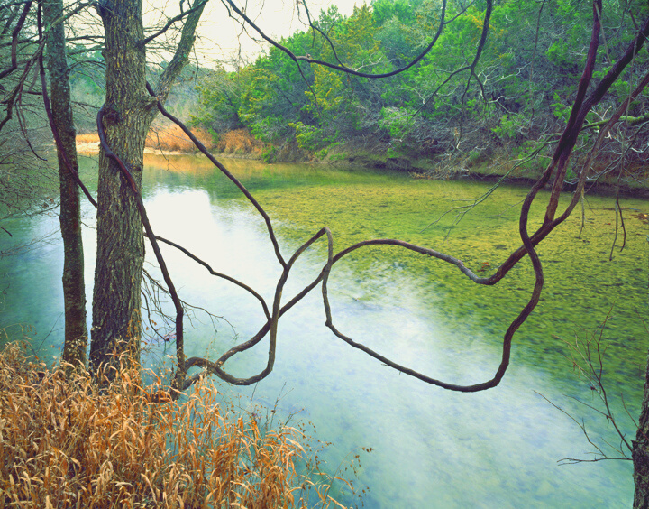
THE PERCENTAGE OF UTILITIES MEETING OR EXCEEDING THEIR 5-YEAR WATER CONSERVATION GOAL IMPROVED
MEETING 5 YEAR WATER CONSERVATION GOALS
Between 2009-2014, 60% of mid and large utilities met or exceeded targets for water use reduction.
Between 2015-2019, 66% of mid and large utilities met or exceeded targets for water use reduction.
Notes:
Speaker: KK

Slide 18
THE PERCENTAGE OF UTILITIES THAT HAVE A LOW GPCD OR SET STRONG CONSERVATION GOALS IMPROVED
SETTING STRONG GOALS
In 2016, 29% of mid and large utilities had achieved a low GPCD (125 or less) or set strong conservation goals (average annual reduction of greater than 1.25%).
In 2020, this percentage increased to 46% of mid and large utilities.
Notes:
Speaker: KK
Additional Data Talking Points:
In 2016, there were 15 medium/large utilities with a GPCD of 125 or less – in 2020, this jumped to 40 (167% increase)
In 2016, there were 9 medium/large utilities with a GPCD of 140 or less – in 2020, this jumped to 19 (111% increase)
Overall, the total number of utilities with a GPCD of 140 or less has more than doubled since 2016

Slide 19
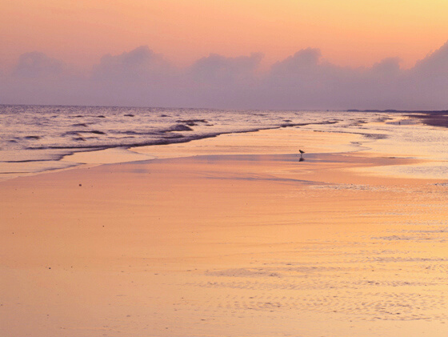
WATER LOSS
WATER LOSS HAS BEEN A
SIGNIFICANT ISSUE FOR UTILITIES ACROSS TEXAS AND IT IS NOT IMPROVING
In 2016, approximately 42% of all utilities reported a loss of more than 10%.
In 2020, 48% of all utilities reported a loss of more than 10%. Average percent water loss has increased by 3% since 2016.
Notes:
Speaker: KK
Additional Data Talking Points:
Only 33% of utilities reported percent water losses below the prior 5-year average (13.9%)

Slide 20
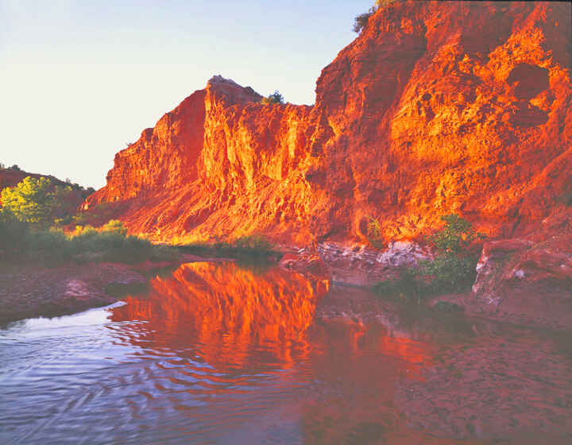
MUNICIPAL CONSERVATION BEST MANAGEMENT PRACTICES (BMP)
THE NUMBER OF IMPLEMENTED
BMPS BY UTILITIES HAS IMPROVED SLIGHTLY.
The number of implemented BMPs,
the average for all utilities has increased by approximately 1 BMP (out of a list of 23 BMPs).
Notes:
Speaker: KK
Additional Data Talking Points:
Medium/large utilities implemented an average of 2 more BMPs compared to small utilities (7.5 BMPs versus 5.5)
Only 3% of utilities were implementing 15 or more BMPs in the 2020 Scorecard (i.e., received full 10 points)
JW on Next Slide

Slide 21
OUTDOOR WATERING RESTRICTIONS
THE PERCENTAGE OF UTILITIES THAT ADOPTED ON OUTDOOR WATERING RESTRICTIONS INCREASED
In 2016, 15% of large and medium-size utilities limited outdoor watering to no more than once-per-week or twice-a-week.
In 2020, 23% of large and medium-size utilities limited outdoor watering to no more than once-per-week or twice-a-week.
Notes:
Speaker: JW
We have seen an increase in the number of utilities that have adopted some form of outdoor watering restrictions, however, over 50% of large and medium-size utilities still do not have any time-of-day or days-per-week outdoor watering restrictions outside of drought periods.
Being proactive about reducing outdoor water use can result in big water savings for Texas utilities. Studies have shown that, annually, outdoor water use for single-family homes in Texas accounts for approximately 31% of water use. Outdoor lawn watering during the summer drives drives up peak water use which can lead to the building of costly water infrastructure to meet those peak water demands thus increasing the cost for sustomers to pay for that infrastructure that is only really needed part of the year.
The 2020 Scorecard does indicate some progress in this area of water conservation, however. As I mentioned, the percentage of large and medium-size utilities embracing some form of limitations on outdoor landscape watering has increased from about a third in the 2016 Scorecard to almost 50% in the 2020 Scorecard.
The Cities of Georgetown, Keller, and Wylie are examples of water utilities adopting limits on outdoor watering since the 2016 Scorecard. The City of Frisco now limits outdoor irrigation to no-more-than-once-a-week and the City of Corpus Christi now had adopted permanent time-of-day outdoor watering restrictions.
Determining which utilities have ongoing or permanent limitations was one of the more challenging data-gathering tasks in preparing the Scorecard. For the most part it necessitated dutiful searching of utility or city websites and in some cases was more difficult to find that it should be.
Utilities could receive up to 15 points on this metric.

Slide 22
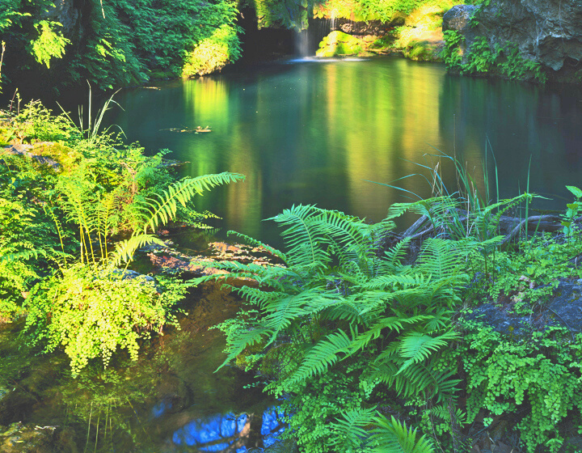
WATER RATE STRUCTURES
A MAJORITY OF WATER UTILITIES IN THE STATE COULD BE SENDING A STRONGER “CONSERVATION PRICING SIGNAL” IN THEIR WATER RATES
Only 45% of large and medium-size water utilities in Texas and only 35% of small utilities have water rate structures that send a strong “conservation pricing signal” to their customers.
Notes:
Speaker: JW
Our last metric A majority of water utilities in the state could be sending a stronger “conservation pricing signal” in their water rates.
Only 45% of larger - medium utilities and only 35% of small utilities have strong conservation-oriented water rates structures.
What do we mean by a strong pricing signal? For the purposes of this analysis, we use publicly available data reported by water utilities to the Texas Municipal League. If the data was not available we looked it up on the utility website. We looked at percent change in the water rate charged per 1000 gallons when a customer’s monthly use is 10,000 gallons rather than 5,000 gallons. If the change in price was greater than or equal to a 40% then the utility received full points on this metric.
Utilities could receive up to 15 points on this question.
Meghan on Next Slide

Slide 23
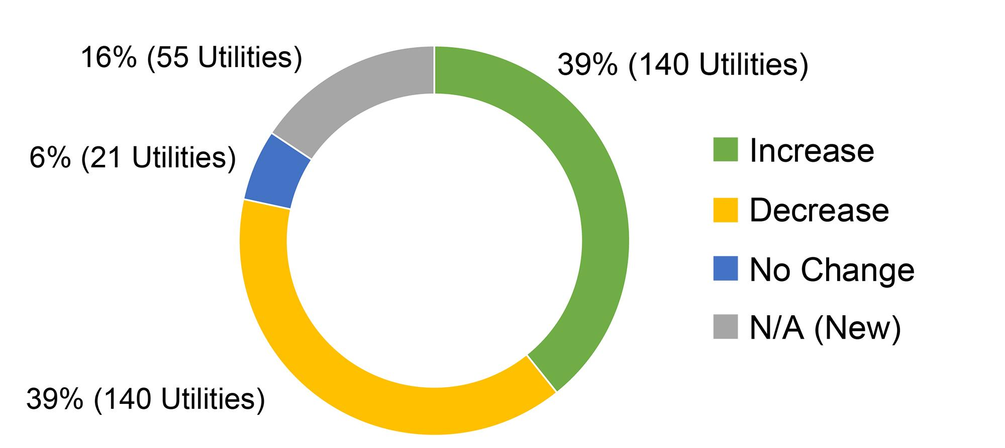
Total Scores
Change in Total Score (2016 Scorecard v 2020 Scorecard)
Overall, an equal number of utilities saw their scores increase / decrease between the 2016 and 2020 Scorecards.
For those utilities that saw a decrease, their score lowered by 9.6 points on average, while the average increase was 9.9 points.
Notes:
Speaker: MB
Overall Texas water utilities as a whole have not significantly improved their efforts on water conservation.

Slide 24
TOP SCORES 2020
TEXAS WATER CONSERVATION SCORECARD
CITY OF HURST
CITY OF AUSTIN WATER & WASTEWATER
CITY OF FORT WORTH
CITY OF LUBBOCK
CITY OF DALLAS WATER UTILITIES
CITY OF WYLIE
CITY OF FRIENDSWOOD
WWW.TEXASWATERCONSERVATIONSCORECARD.ORG
Matagorda Bay
Photo by Charles Kruvand
Notes:
Speaker: MB

Slide 25
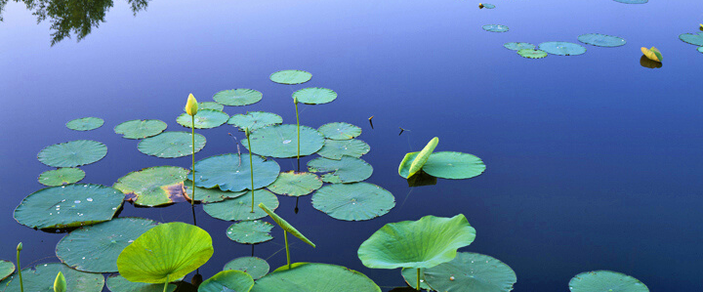
OPPORTUNITIES FOR IMPROVEMENT
Reduce percent water loss through more advanced water loss control program.
Establish more robust outdoor watering restrictions, including no more than once-per-week or twice-per-week outdoor watering schedules.
Incorporate broader mix of BMPs into conservation program.
Notes:
Speaker: MB
57% of medium/large utilities have ZERO outdoor watering restrictions in place, while 20% only have time of day restrictions

Slide 26
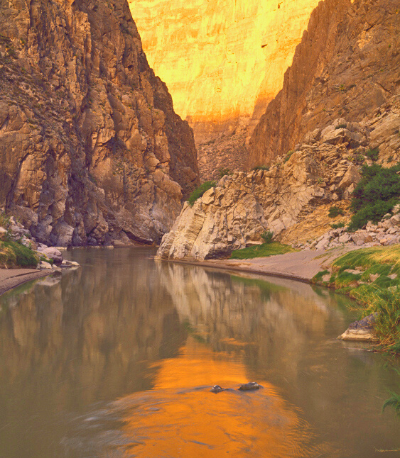
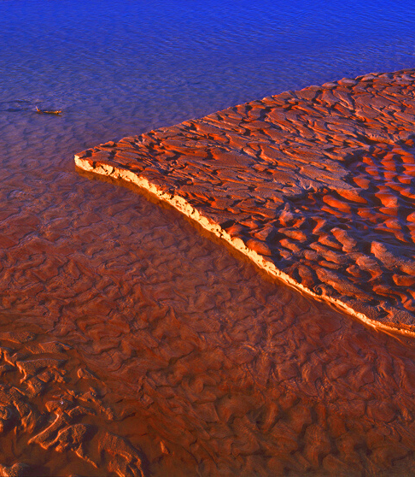
RECOMMENDATIONS
Notes:
Speaker : JW

Slide 27
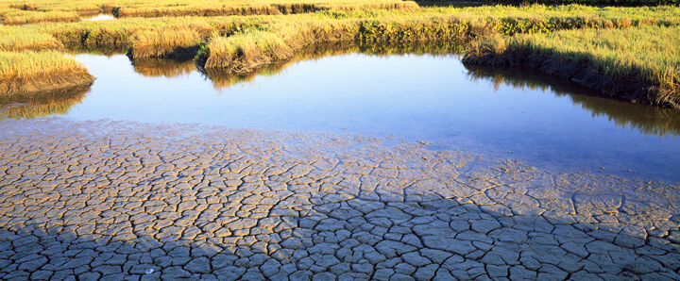
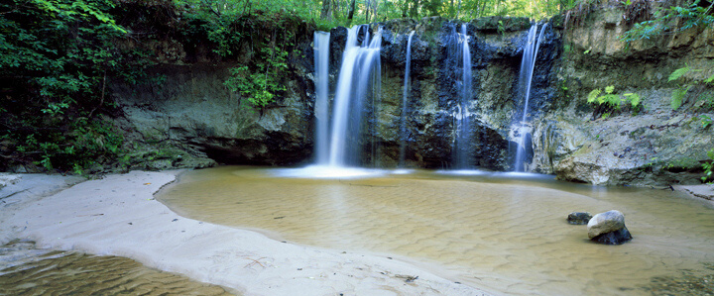
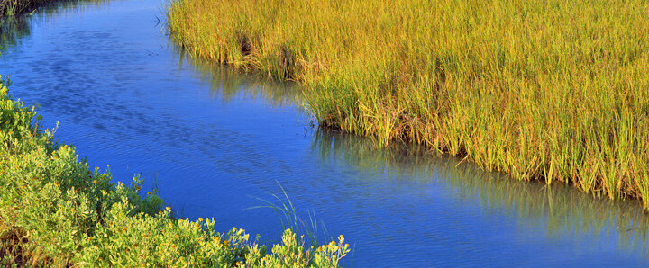
For Utilities
Adopt outdoor watering limitations on an ongoing basis, not just during drought.
Adjust water rate structures to accurately reflect the cost and value of water.
Evaluate the potential to tap state financial assistance from the State Water Implementation Fund for Texas.
Notes:
Speaker : JW
Adopt outdoor watering limitations on an ongoing basis, not just during drought. A significant reduction in annual and peak water use could be realized if a municipal water utility implemented required outdoor watering limitations (time-of-day and days-per-week limitations) year-round or at least on a seasonal basis.
Adjust its water rate structures to accurately reflect the cost and value of water and to send a stronger conservation- pricing signal that will effectively encourage customers to conserve. Any water rate structure, however, should include life-line rates that provide socially vulnerable populations, such as low-income customers, a sufficient amount of water to meet basic needs at an affordable price. Evaluate the potential to tap state financial assistance from the State Water Implementation Fund for Texas (SWIFT) and the related State Water Implementation Revenue Fund for Texas (SWIRFT), or other TWDB funding mechanisms, to finance certain water conservation activities, including especially water loss control.

Slide 28
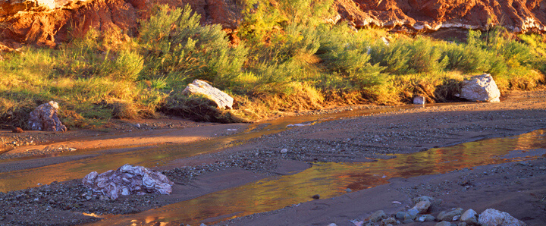
For Texas Water Development Board
Prepare and make available model Water Conservation Plans
Evaluate possible ways to encourage more water utilities to tap SWIFT and SWIRFT.
Communicate expeditiously with a retail public water utility when a Water Loss Audit has been removed.
Notes:
Speaker : JW
Prepare and make available model Water Conservation Plans – This should be specifically tailored to the circumstances of large, medium-size, and small retail public water utilities – incorporating preferred per capita water use reduction goals, reasonable outdoor landscape watering limitations, relevant conservation BMPs, online accessibility of water conservation information, and other appropriate conservation and accountability measures. Evaluate options to encourage more water utilities to tap SWIFT and SWIRFT to finance certain water conservation activities, including water loss control, and suggest any changes needed in those funding mechanisms to accomplish the water conservation goals for these funding programs. The enabling legislation requires TWDB to undertake to apply not less than 20% of these funds for water conservation Communicate expeditiously with a retail public water utility when a Water Loss Audit submitted by the utility is rejected and provide guidance to the utility in correcting any problems with the Audit and improving the utility’s auditing process.

Slide 29
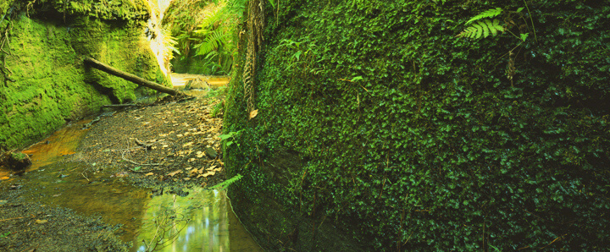
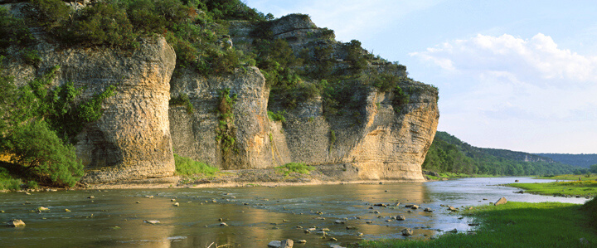
For The State of Texas
Conduct a study on water conservation pricing signals
Evaluate potential mechanisms for ensuring enforcement of requirements for submittal of reports.
Consider requiring third-party validation of Water Loss Audits to improve the accuracy.
Notes:
Speaker : JW
Conduct a study on how water conservation pricing signals are calculated and how retail public water utilities might better use those signals in modifying their water rates. Research exists that demonstrates how to better design water rate structures to be not only affordable to the customer, but also maintain revenue for the utility while promoting conservation.
Evaluate potential mechanisms for ensuring enforcement of requirements for submittal of 5-year Water Conservation Plans, Annual Reports, and Water Loss Audits and adopt the mechanism or mechanisms that are judged most likely to be effective in achieving the highest possible compliance with required submittals. Consider requiring third-party validation of Water Loss Audits to improve the accuracy of those Audits so that they provide utilities and the State of Texas with the information needed to pinpoint and address water loss problems. Implementing these recommendations will help promote the wise and efficient use of our limited water resources in Texas.

Slide 30
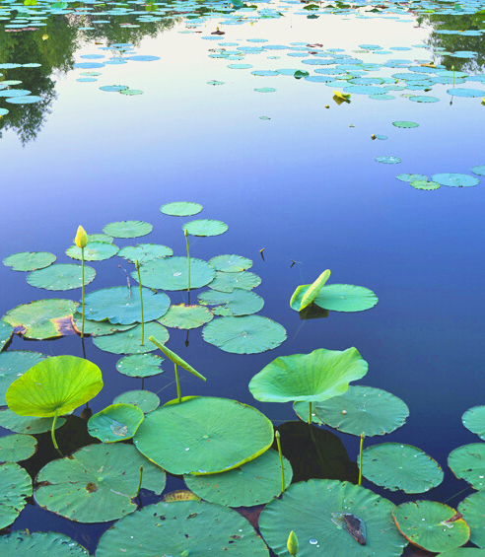
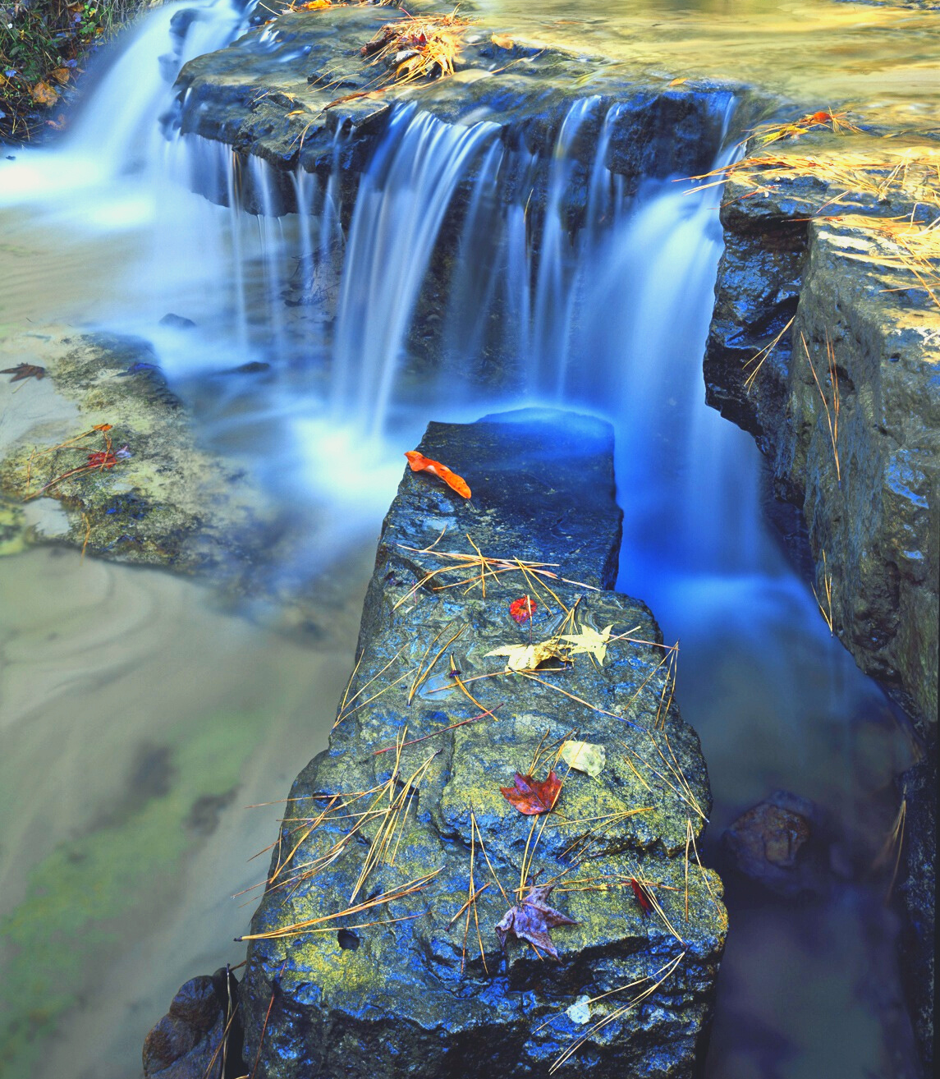
QUESTIONS?

Slide 31
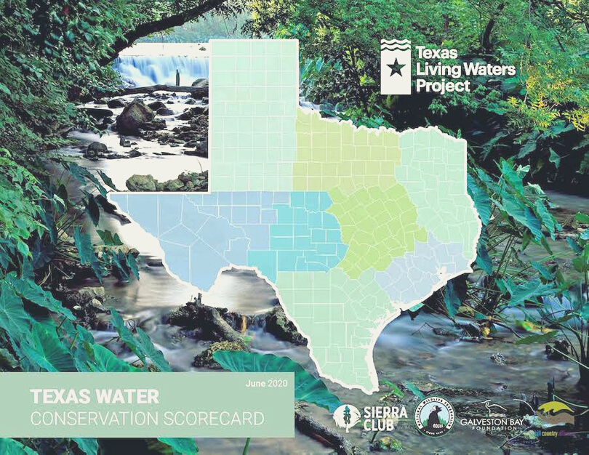
THANK YOU!
READ THE FULL REPORT AT:
http://www.texaswaterconservationscorecard.org/
Jennifer Walker - walkerj@nwf.org
Ken Kramer - kramerkenw@gmail.com
Meghan Bock- mbock@AIQUEOUS.com
Texas Living Waters Project

