Slide 1
The Texas Water Loss Audit Validation (TWLAV) Study Results from the 2020 Water Loss Audit Validations
Daniel Rice
Municipal Conservation Team Lead
Unless specifically noted, this presentation does not
necessarily reflect official Board positions or decisions.

Slide 2
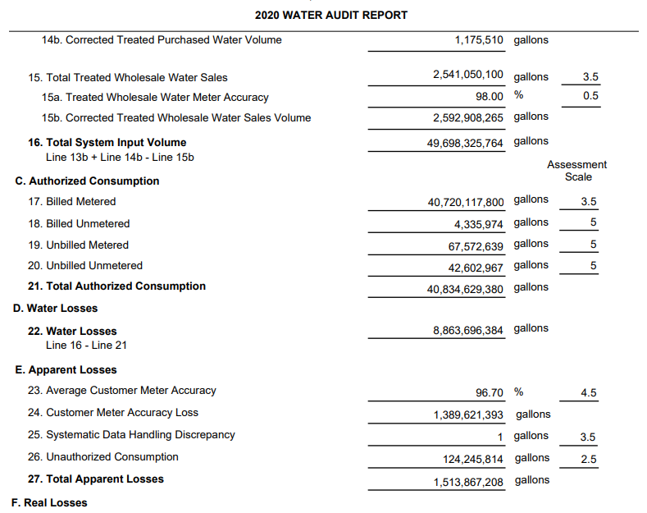
Notes:
Before we discuss the study – a water loss auditor completes their water loss audit which includes self-assessing their data collection and reporting policies and practices

Slide 3
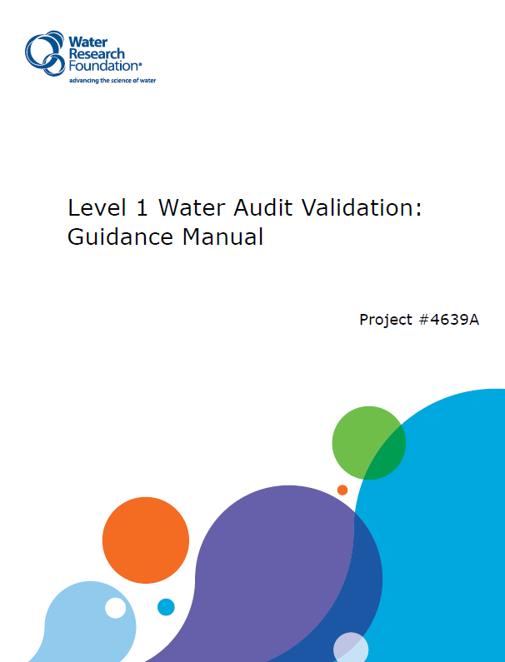
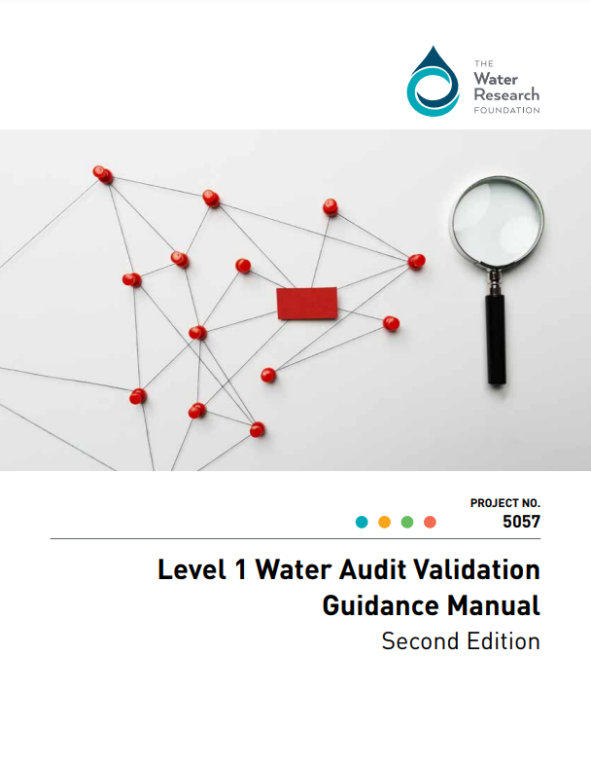
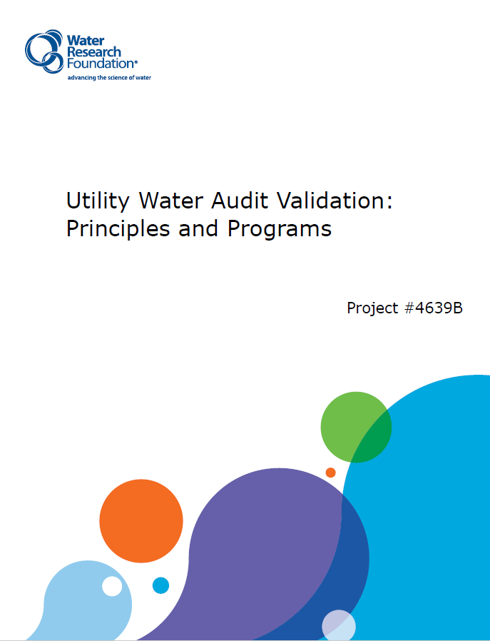
Validation
Notes:
Then comes the process of validation. Validation is outlined in these WRF reports. WRF Project 5057 updated to include changes in the AWWA V6 FWAS.

Slide 4
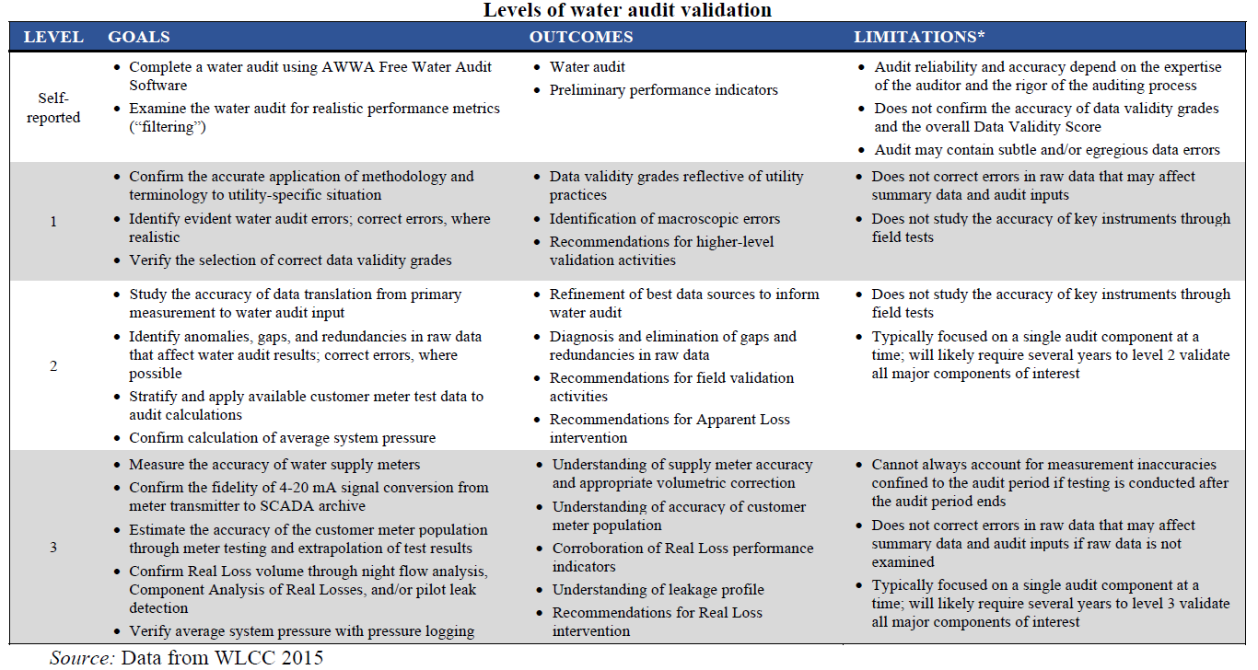

Slide 5
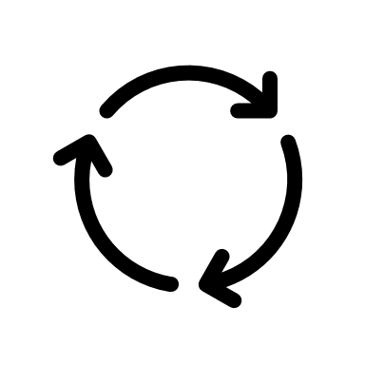
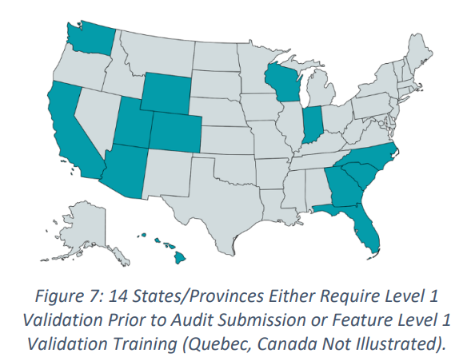
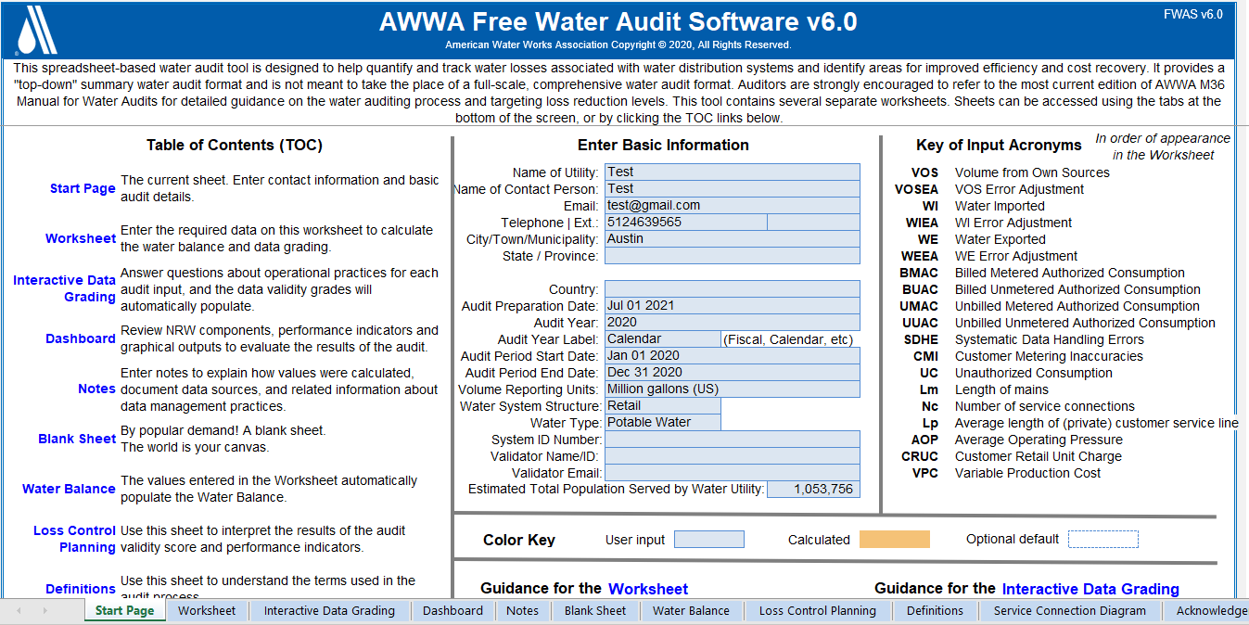
TWLAV Study: Beginnings
TWDB WLA Program always evolving
Interest in best management practices to help our customers
Improving water use, loss, and conservation data improves water planning
Money available
Source: WRF Project 5057
Notes:
Encouraged by other states programs and the industry standards

Slide 6
TWLAV Study: Methods
Voluntary Level 1 Validation of 10 utilities
< 10,000; 10,000-49,999; 50,000-100,000 population
Good geographic representation
Draft validation questions
Review historic water loss data
Webinar
Validation meetings
Validation report to utilities with recommendations
Notes:
Limited to 10 due to funding

Slide 7
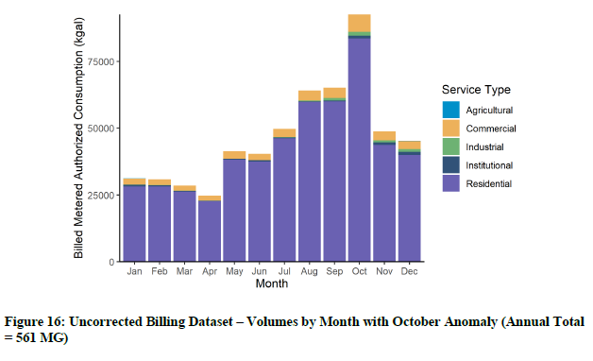
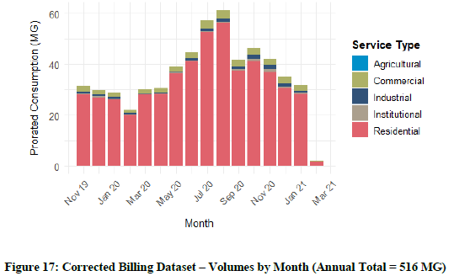
TWLAV Study: Methods cont’d
Advanced validation was performed
1 utility - Billing Data Analysis
2 utilities – Real Loss Component Analysis

Slide 8
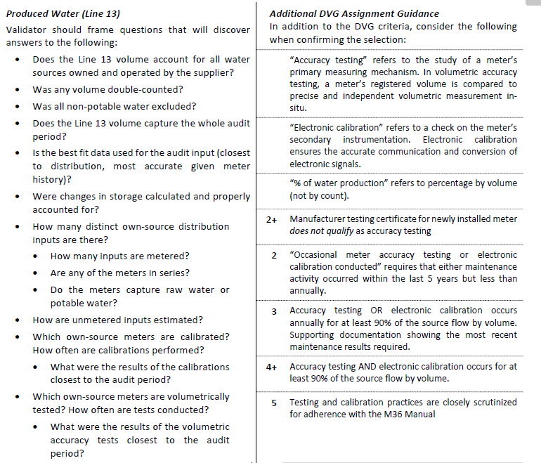
TWLAV Study: Validation Questions
Notes:
Validators use the methodology of validation questions to discuss each field in the audit to determine if the assessment score was accurately assessed. In asking the questions, they may find that the reporting of information was not the best available information and ask for the utility to provide all data and report it accurately in the audit. The validation meetings help inform better data collection and reporting practices.

Slide 9
TWLAV Study: Deliverables
Notes:
Once the validator feels the validation is complete, they provide a validation report with pre/post validation scores of assessment score and performance indicators; and recommendations for next steps.

Slide 10
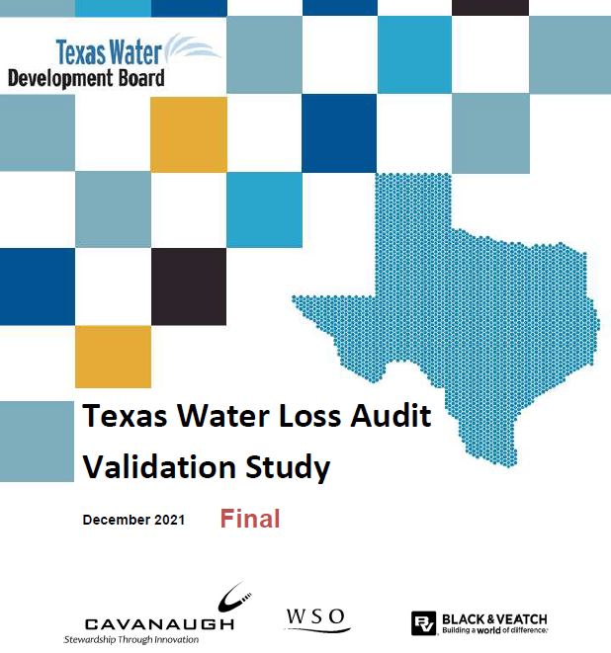
TWLAV Study: Deliverables
Notes:
Once all validations were complete the contractors provided the final deliverable, the final report on the validation study

Slide 11
TWLAV Study: Results
Level 1 Validation updates the data validity scores but can also update the data inputs.

Slide 12
TWLAV Study: Results

Slide 13
TWLAV Study: Results

Slide 14
TWLAV Study: Results

Slide 15
TWLAV Study: Results

Slide 16
TWLAV Study: Utility Recommendations
Production Meters
Customer Meters
Production Cost
Retail Cost
Lag-time Correction
Test
Calibrate
Sample Test
Test Large Usage
More accurate values
Improve Apparent Loss Costs
Direct/Indirect Expenses
Improve Real Loss Costs
Temporal alignment of Billed and Supplied
Most utilities had an Assessment Score of 50-80, suggesting next steps.

Slide 17
TWLAV Study: Findings
1
Improved reliability of self-reported water loss audit results
2
Improved data management practices
3
Some of supporting data already tracked and reported
4
Staff time availability adequate to participate in Level 1 validation

Slide 18
TWLAV Study: Recommendations
1: Expand the Water Loss Audit Validation Study into a Regional Validation Program (RVP)

Slide 19
TWLAV Study: Recommendations
2: Require Level 1 Validation for all annually required water loss audits

Slide 20
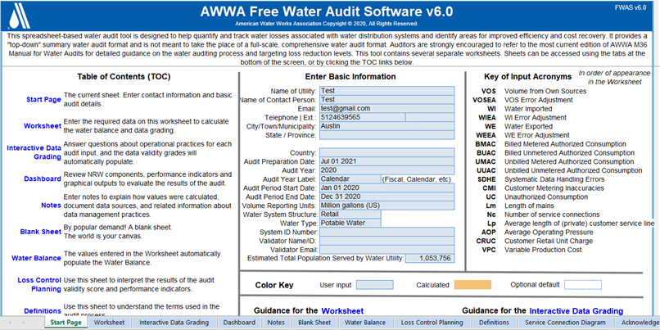
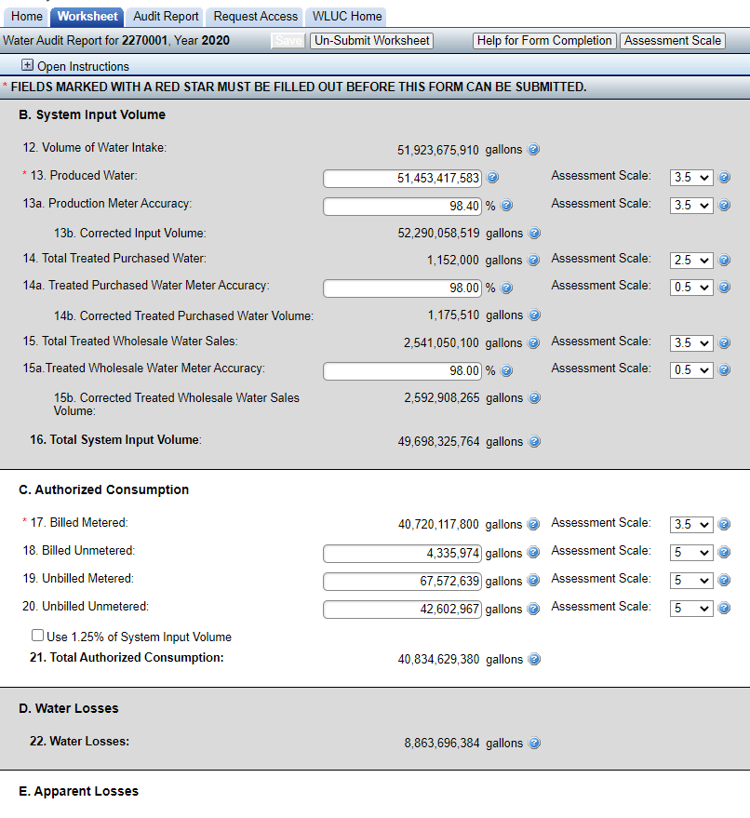
TWLAV Study: Recommendations
3: Closer align with AWWA FWAS V6

Slide 21
TWLAV Study: Next Steps
Continue to evolve with the industry
Expand water loss program
Resources dictate possibilities
Further stress importance of data validation
Continue to work closely with regional water planning

Slide 22
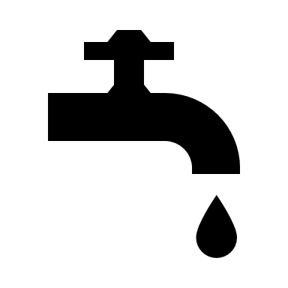
Contact Information
TWDB Staff
Study Contractors
John Sutton
Conservation Manager
John.Sutton@twdb.texas.gov
Daniel Rice
Municipal Conservation Team Lead
Daniel.Rice@twdb.texas.gov
Texas Water Development Board’s Texas Water Loss Audit Validation Study

