Slide 1
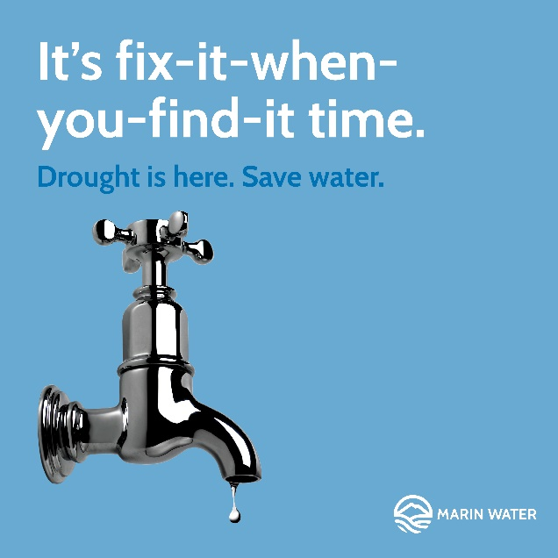




Marin Water's Drought Response
February 15, 2022

Slide 2
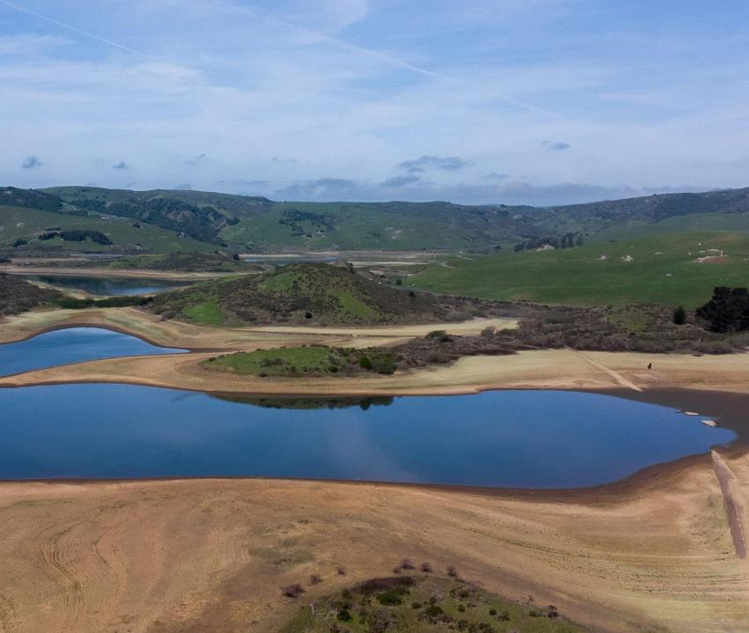
Marin Water Overview
100% Locally Sourced Water:
  75% from reservoirs on Mt. Tamalpais and in west Marin
  25% from Sonoma County’s Russian River water system
California’s oldest municipal water district (Chartered in 1912)
Marin County’s largest drinking water provider, serving more than 191,000 people in central and southern Marin
Protecting and preserving 22,000 acres of watershed land on Mt. Tamalapias and in west Marin

Slide 3
Rainfall Total
Lake Lagunitas
Historically low rainfall period since January 2020 (21 consecutive months) – second lowest in 143 years
WY 2021 Total
20.42 in
Notes:
August 3 – 32,300 ac-ft (< 41% of total capacity)

Slide 4
Historical Total Reservoir Storage
Notes:
August 3 – 32,300 ac-ft (< 41% of total capacity)

Slide 5
Projected Reservoir Storage
40% conservation savings
Notes:
Local Historical rainfall runoff patterns
Criticality of conservation to save considerable water given uncertainty surrounding rainfall patterns
-noting that at historic average rainfall-runoff amounts, reservoir storage is projected to be in the vicinity of 50,000 acre-feet at the end of next spring, so it will take considerable rainfall to fill the reservoirs and move the district back into a position
Projected Reservoir Storage: Next, moving into projected reservoir storage levels over the next 18 months. Going into the summer and fall months, no rainfall is considered until early October or so. At the same time, irrigation picks up and we expect the next summer months to be a critical opportunity to decrease outdoor water use and save that water. As shown here in the dashed blue line, without conservation, we project around 25,000 ac-ft if we receive 50% of normal rainfall in the early fall winter months. With conservation, significant impact can be on storage levels be seen here on the solid blue line, up around 30,000 ac-ft, and that is really contigent on IF WE ARE ABLE TO REACH OUR TARGET.
n we’ve seen in past years with more consistent rainfall

Slide 6
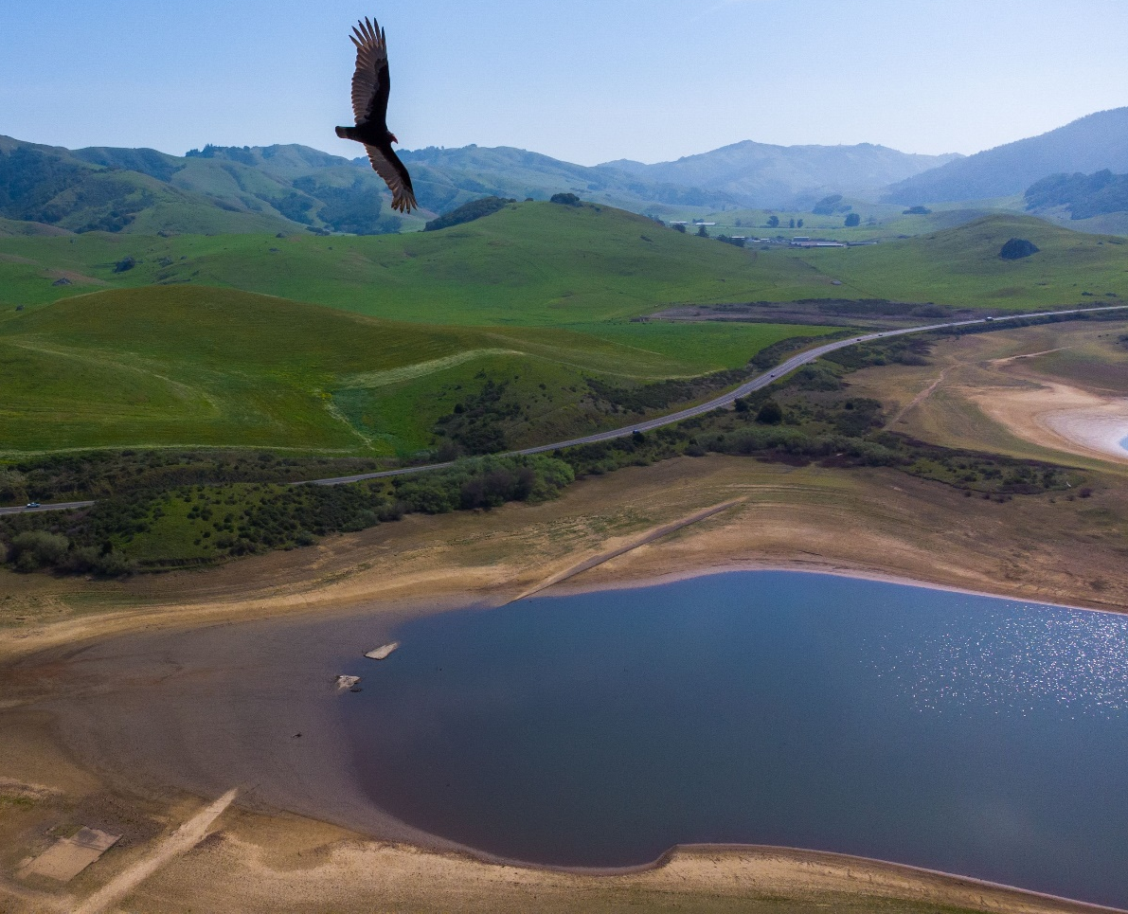
Water Use Restrictions - Board Actions
February 16: Marin declares a drought and asks all customers to voluntarily conserve water
April 20: Marin Water declares a water shortage emergency and adopts mandatory water use restrictions, including a 40% district-wide reduction goal
May 04: Marin Water adopts irrigation restrictions (2 day/wk)
July 06: Marin Water adopts tighter irrigation restrictions (1 day/wk)
July 20: Marin Water adopts landscape restrictions for new service connections
September 21: Marin Water establishes water use limits and excess use penalties
October 19, 2021: Marin Water adopts a district wide prohibition on winter irrigation (Dec-May) and pool filling

Slide 7
Actual vs. Targeted Water Use
May 4: Irrigation
2 days/wk spray
July 6: 1 day/wk spray, assigned day
Sept 21: Water use limits
Oct 19: No winter irrigation allowed
April 20: Established 40% Goal
Feb 16: Voluntary
Action

Slide 8
Timeline of Drought Actions
$3/sq-ft turf Cash for Grass
Pool Cover Rebate
Direct Install Sheet Mulching
Hot Water
Recirculating Rebate
Flume Rebate
Feb 16: Voluntary
Action
April 20: 40% Goal
May 4: Irrigation
2 days/wk spray
Jul 20: Restrictions on new connections
July 6: Irrigation
1 day/wk spray
Sept 21: Water use limits
Oct 19: No winter irrigation
Notes:
Two historically dry years
Progressive actions taken by the board as reservoir levels dropped to historically low levesl

Slide 9
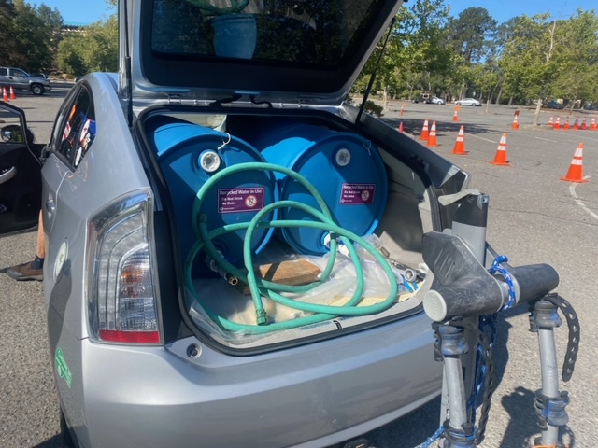
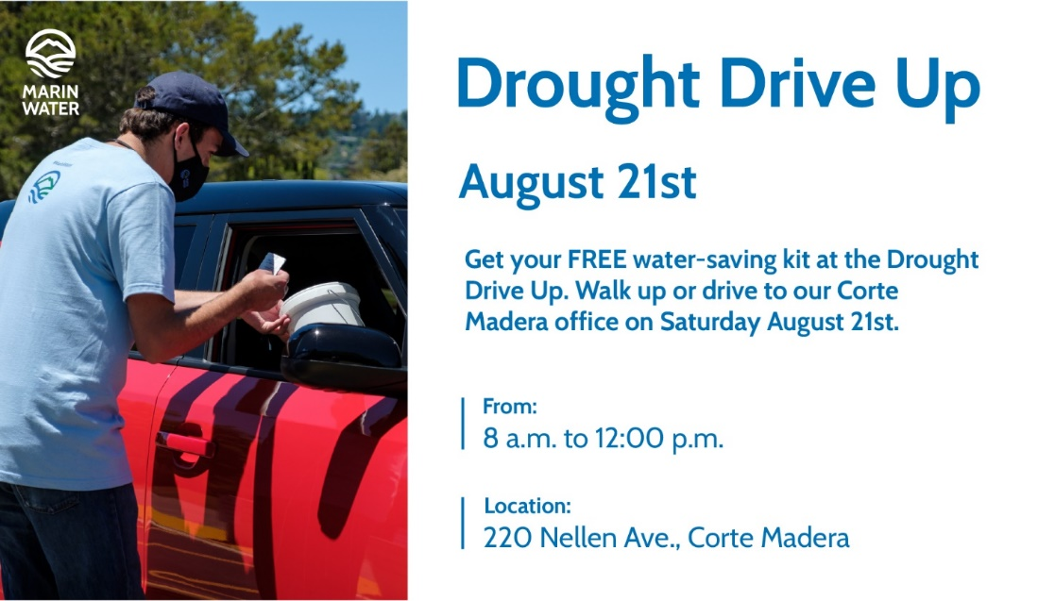

Boots on the Ground
Landscape Professional 5-part Webinar Series
  Strategies for Survival: Trees, Shrubs and Turf
  20—40 attendees at each session
Recycled Water Fill Station
Regional Drought Drive-Up Events

Slide 10
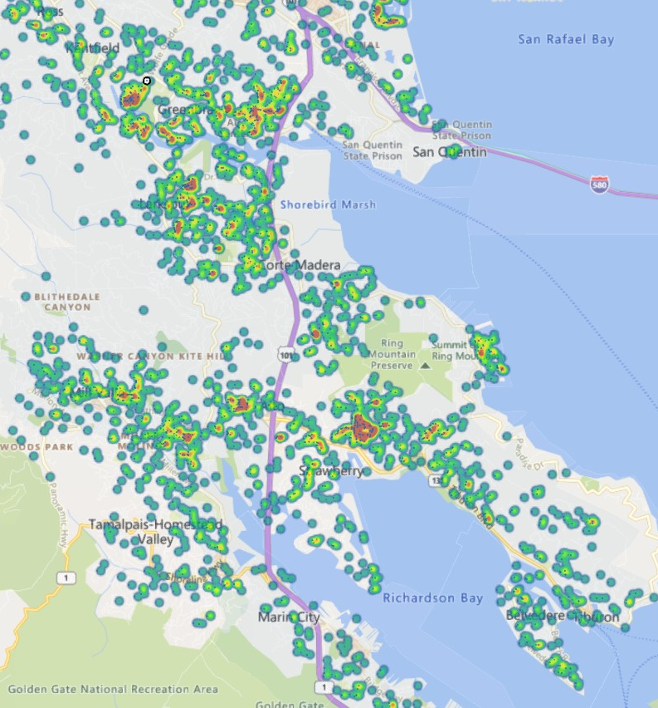
Water Waste Program
Educate customers and ensure compliance of mandatory water restrictions through routine patrols
  2,336 Door hangers
  1,621 First notifications
  66 Second notices
  9 Third notices

Slide 11


Community Engagement & Outreach
Community Partners
  Trusted voices sharing drought and conservation messages

Slide 12

Community Engagement & Outreach
Gym, Hotel and Restaurant Outreach
  Developed and distributed materials to all local establishments
Tour de Drought Virtual Cycling Event
  Cycling event (MTB, road) throughout watershed
  Register for a free MW water bottle
  Self guided rides tracked on everyone’s fav riding app
  Partnership with Marin County Bicycle Coalition and local business

Slide 13
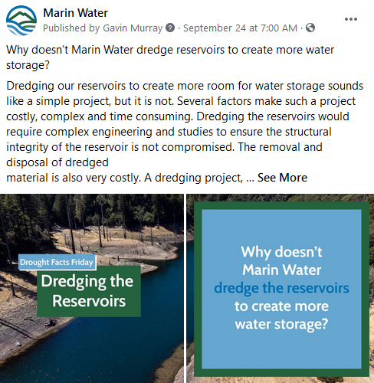
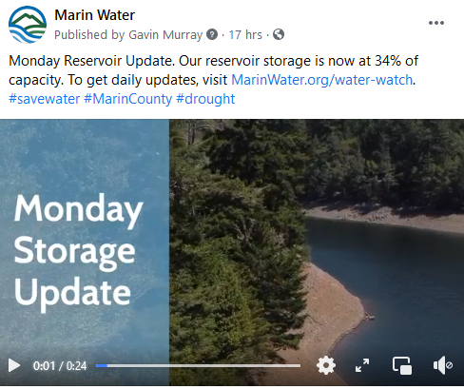
Community Engagement & Outreach
Drought Facts Friday
Monday Storage Update

Slide 14


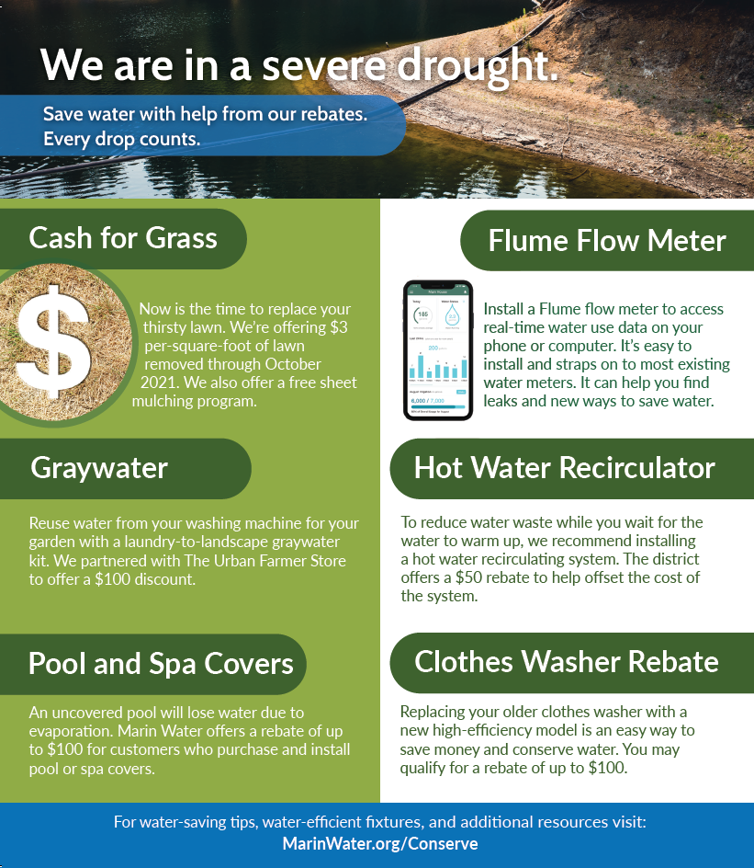
Community Engagement & Outreach
Special Rebate Insert

Slide 15

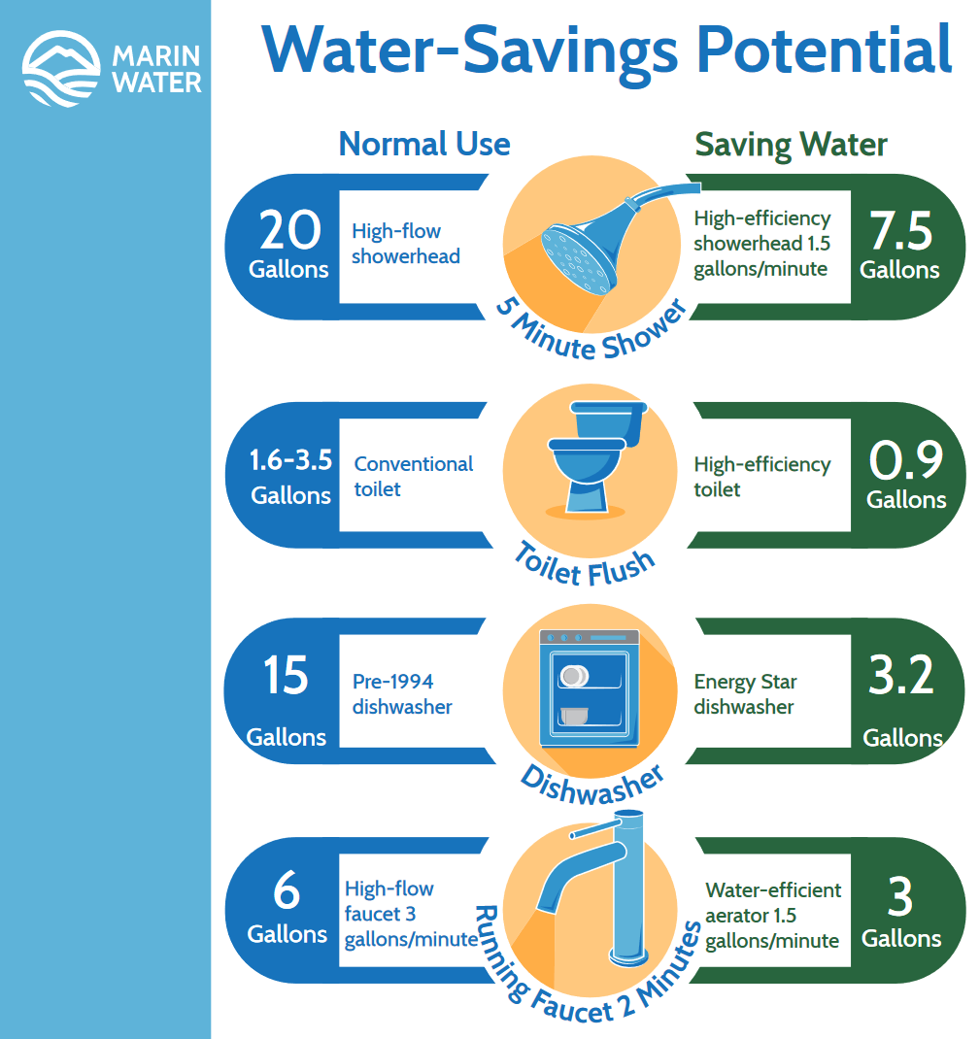

Community Engagement & Outreach
Yard signs
Water savings guide

Slide 16
Customer Inquiries
Customer emails & phone calls increase by a factor of 10

Slide 17
Excess Use Penalties – Winter (Dec-May)
Single-Family Customers Assume 4 people/household
Irrigation Customers
$15.00/ccf
$15.00/ ccf
$10.00/ ccf
$10.00/ccf
$5.00/ ccf
$5.00/ccf
Current per CCF:
Current per CCF:
$4.54
$7.87
$13.25
$21.29
$4.44
$11.89
$17.81
Tier 1 Tier 2 Tier 3 Tier 4
Tier 1 Tier 2 Tier 3
GPCD (4pph):
0-65 66-150 151-249 250+

Slide 18
Excess Use Penalties – Summer (Jun-Nov)
Single-Family Customers: Assume 4 people/household
Irrigation Customers
$15.00/ ccf
$15.00/ccf
$10.00/ ccf
$10.00/ccf
Current per CCF:
Current per CCF:
$4.54
$7.87
$13.25
$21.29
$4.44
$11.89
$17.81
Tier 1 Tier 2 Tier 3 Tier 4
Tier 1 Tier 2 Tier 3
GPCD (4 pph):
0-81 82-184 185-309 310+

Slide 19
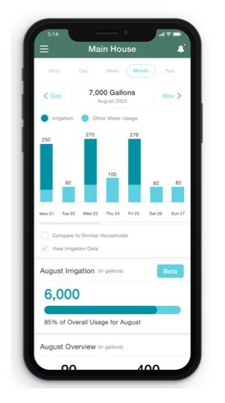
Incentive Programs
MarinWater.org/Rebates
Cash for grass $3/sq ft rebate
Mulch madness direct install sheet mulching
Flume Smart Home Water Monitor
($115/customer pays $50)
Pool or Spa Covers ($100)
Hot Water Recirculating System ($50)
High Efficiency Toilets ($150)
Smart Irrigation Controllers ($100)
Graywater: Laundry-to-Landscape kits ($100)
Rain barrels and cisterns (.50/gallon, $1k max)
High Efficiency Clothes Washers ($100)
NEW
EXISTING

Slide 20
Drought Program Participation
 | June | July | August | Sept | Oct | Nov | Dec | Monthly Target (revised)
Turf Programs (sqft) | 44,627 | 94,285 | 94,557 | 98,903 | 122,143 | 38,161 | 13,695 | 400,000
Flume Devices | 619 | 473 | 358 | 155 | 114 | 223 | 76 | 450
Clothes Washers | 62 | 24 | 30 | 21 | 25 | 35 | 20 | 20 (50)
Rain Barrel/ Cisterns | 7 | 1 | 4 | 3 | 9 | 14 | 9 | 10 (25)
Pool Covers | 25 | 53 | 41 | 65 | 53 | 27 | 11 | 10 (50)
Hot Water Recirculation Systems | 27 | 2 | 9 | 23 | 8 | 24 | 9 | 5 (20)
Graywater Incentives | 4 | 12 | 5 | 5 | 7 | 2 | 0 | 10 (25)
High Efficiency Toilet | NA | NA | NA | 1 | 5 | 10 | 14 | 25

Slide 21
Lawn Removal
Cash for Grass
Mulch Madness
Shift from low incentive with high barriers to a high incentive with low barriers
Rebate increased from $1 to $3/sqft
Planting requirement removed
Timeline reduced from 90-days to 45-days
Replaced program for sheet mulching materials
Direct install sheet mulching and irrigation conversion
Partnership with Conservation Corps North Bay

Slide 22
Lawn Removal Observations
Staffing & training
  2 temp field staff did the bulk of the field work
Terms & conditions
  Timing
  Sheet mulching Vs other materials
Replanting
  The challenge for 2022!

Slide 23


Water Supply Projects Summary
Conservation – Continue as top priority, improve, refine and enhance
Sonoma Water - Collaborate on all opportunities to address the drought
Desalination – timing dictates temporary, capacity limited
Emergency Intertie – feasibility established and pursuing project design
Fog Harvesting – Limited capacity makes it unsuitable for larger volumes
Solar Desalination – Land required not available in Marin
Excavating reservoirs – 10,000 AF = 16.1 M cubic yards (>400,000 truck loads)
Water by truck, barge or rail – Limited capacity, cost & logistics, considering as last resort
Ground Water Storage and Recovery – longer term opportunity, no near term solution for drought
Recycled Water – Residential Fill station, commercial hauling, expansion of purple pipe

Slide 24


What’s next?
Repeal drought restrictions
Citizens Advisory Committee
  Residential Non-functional turf
  Drought response actions including water budgets
Prohibition on commercial non-functional turf
Update the Water Shortage Contingency Plan
Replanting Outreach
Net zero water offsets for new development
Full scale AMI
Additional Water Supply!
Notes:
Voluntary 15% when we remove the emergency declaration next month.
We are doing the full CEQA eval and evaluating all alternatives. (more SW, pipe, desal, more recycled water, etc)

Slide 25


Carrie Pollard
CaPollard@MarinWater.org
415.945.1522

