Slide 1
Planning for Extremes
City of Round Rock, Texas
Central Texas Water Conservation Symposium
February 2022

Slide 2
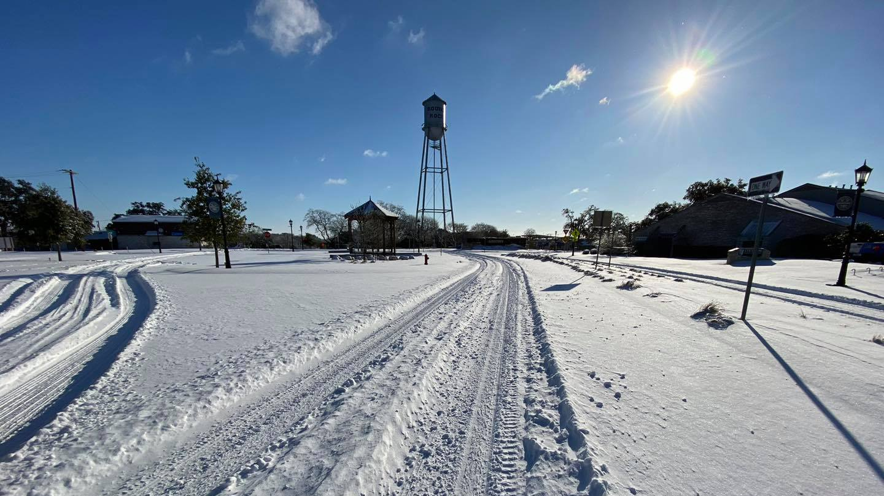

Slide 3
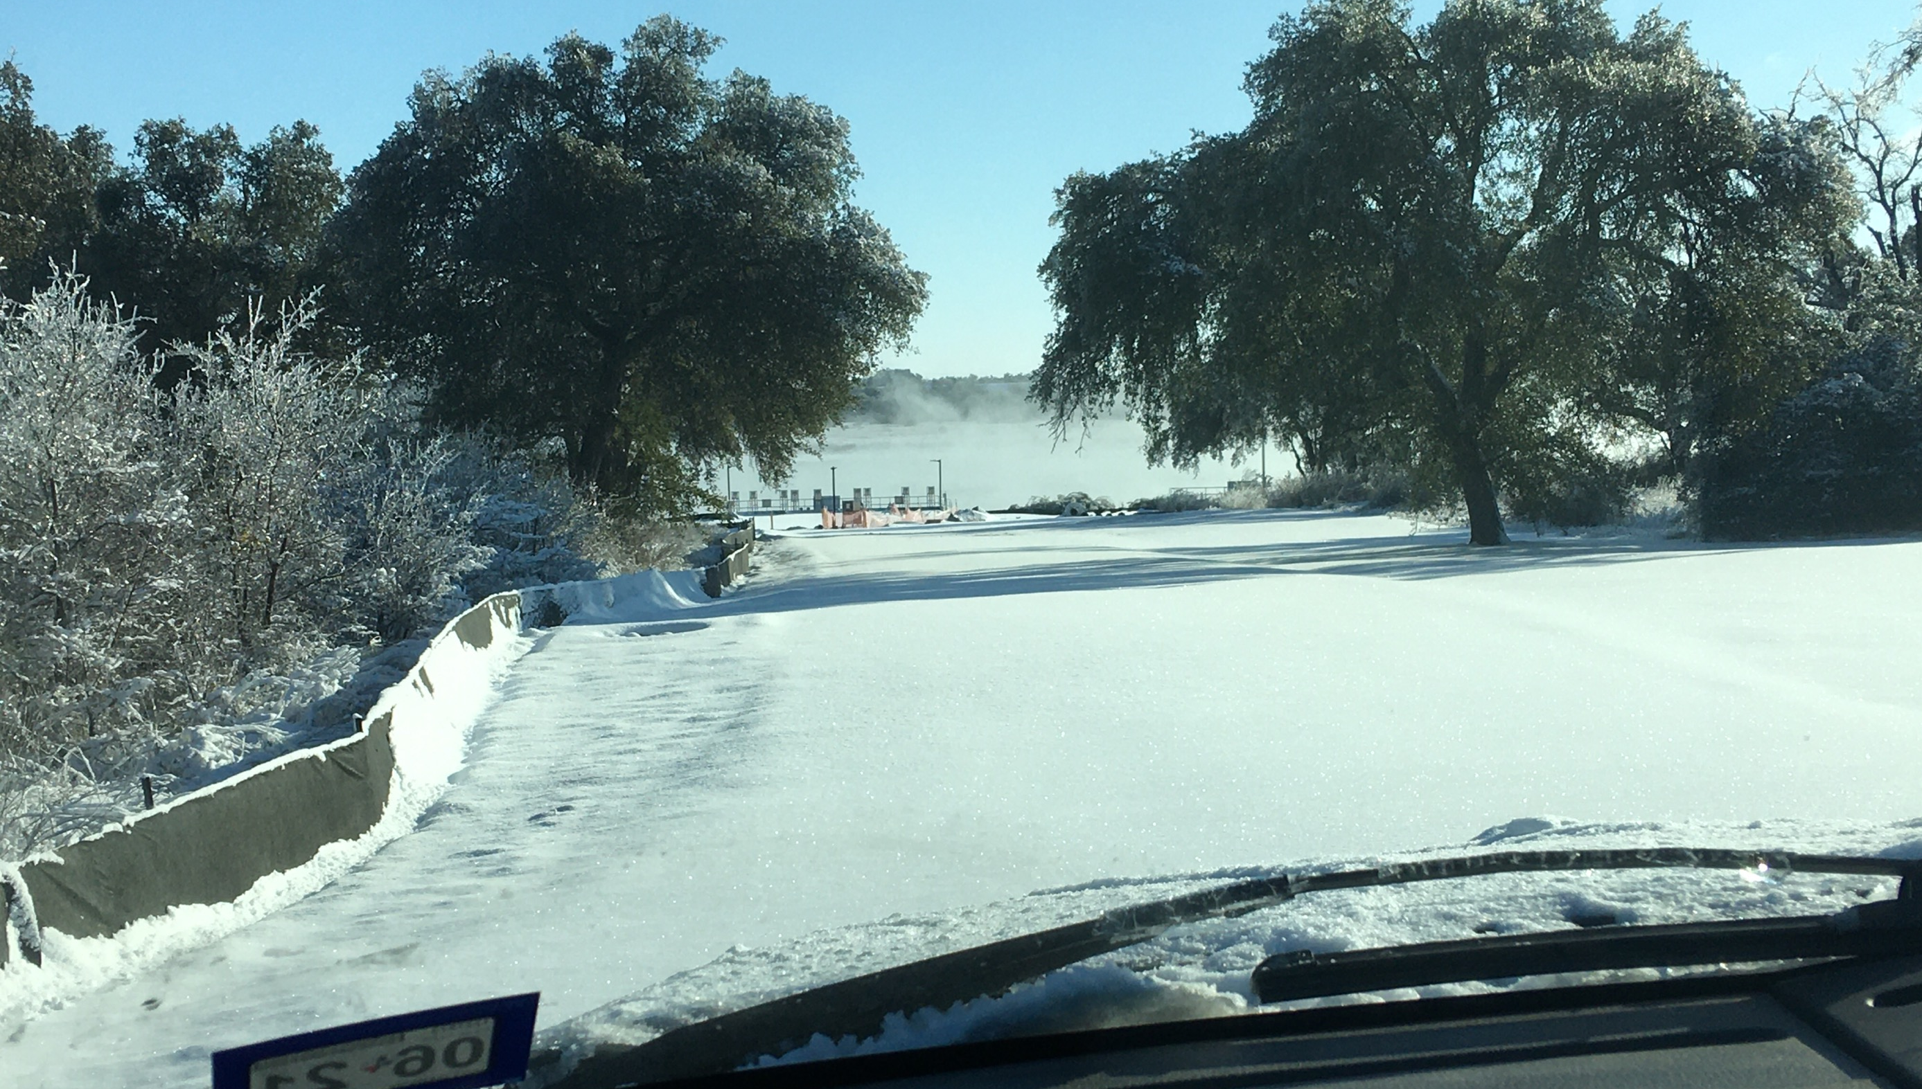

Slide 4
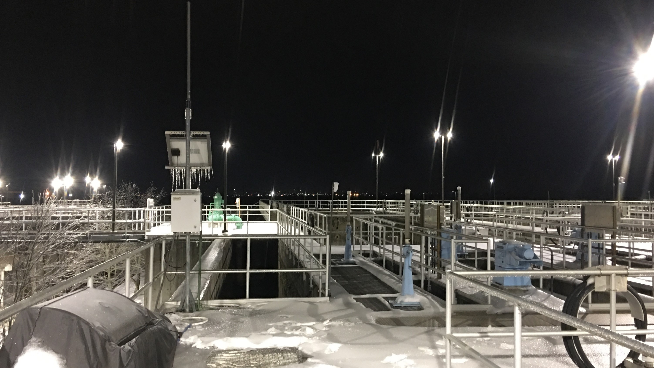

Slide 5
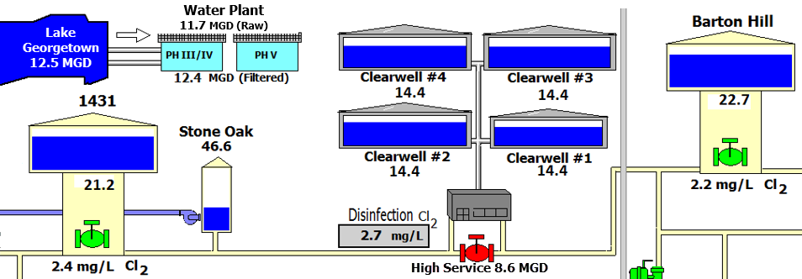
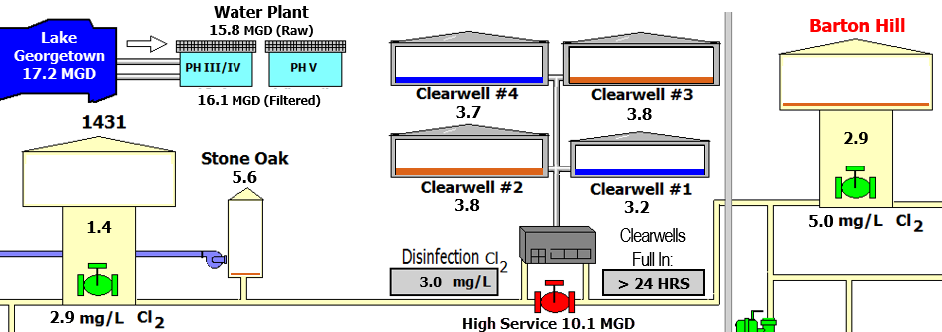
Sunday, February 14
Wednesday, February 17

Slide 6
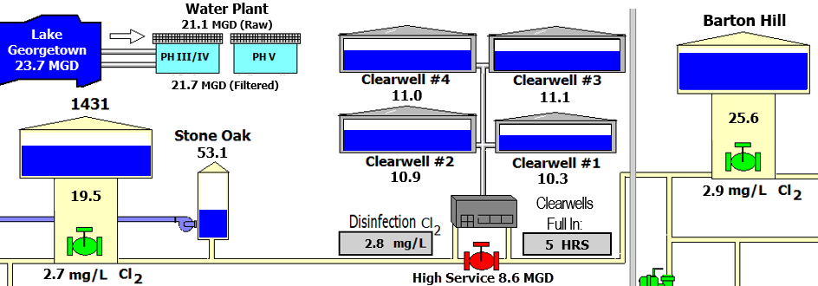
Sunday, February 14
Friday, February 19
Wednesday, February 17

Slide 7
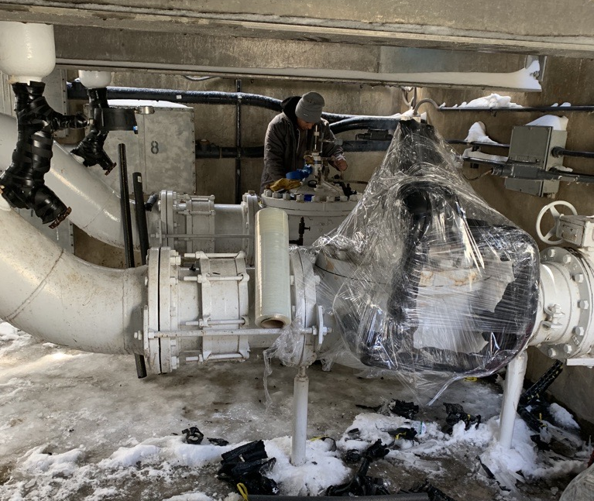
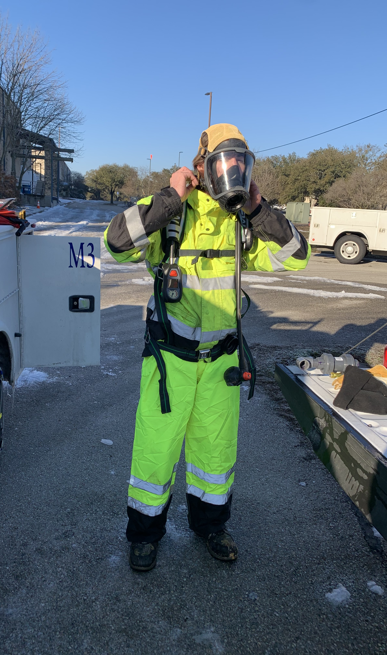
Notes:
From Rich Reedy 7/25/16

Slide 8
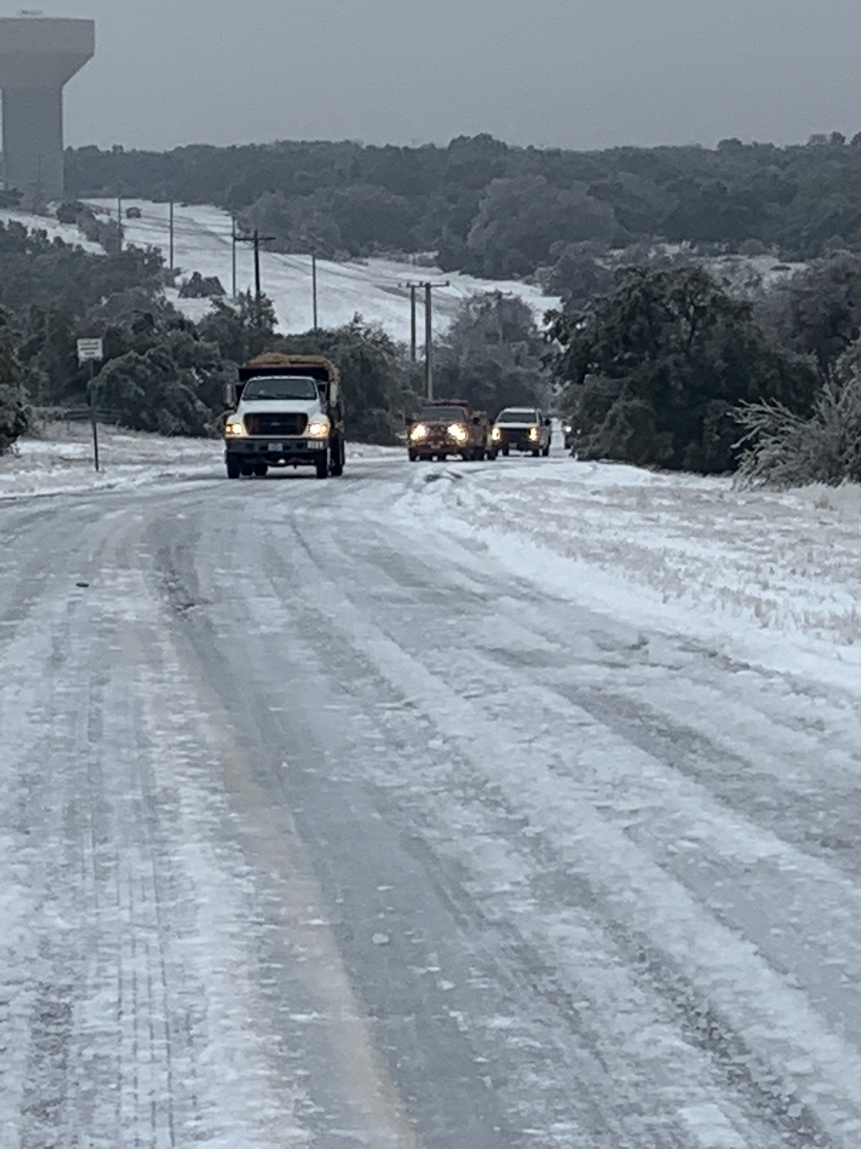
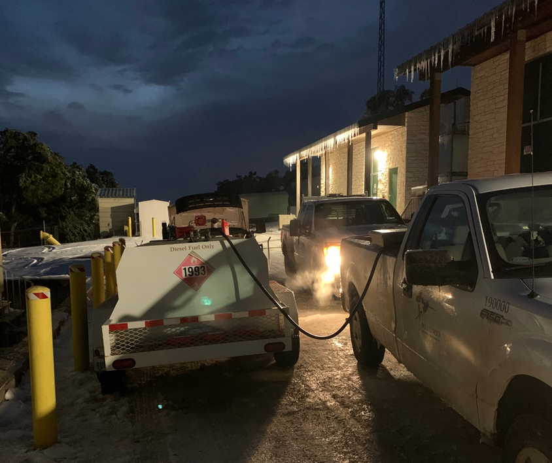

Slide 9
Sunday, February 14
Wednesday, February 17
Friday, February 19

Slide 10







