Slide 1
Climate Change and Extreme Weather: Three Ways of Knowing
John W. Nielsen-Gammon
Texas A&M University

Slide 2
Attributing a trend to climate change: three ways
Is there a clear historical trend?
Do models project a consistent future trend?
Is there a sound physical understanding of why there should be a trend?
Do the magnitudes check out?
For further reading: https://www.nationalacademies.org/our-work/extreme-weather-events-and-climate-change-attribution

Slide 3
Degrees/Decade
°F
°C
0.44 - 0.47
0.42 - 0.44
0.39 - 0.42
0.36 - 0.39
0.33 - 0.36
0.31 - 0.33
a
0.28 - 0.31
b
0.25 - 0.28

Slide 11
Two types of extreme event drivers
“Thermodynamic” (the way things are)
  Example: Warm air holds more moisture
    So heavy rain should increase
  Example: The Arctic is warming faster than the rest of the globe
    So Texas winter cold should become milder
“Dynamic” (the way things behave)
  Example: The maximum intensity of hurricanes is increasing
    So some hurricanes will produce heavy rain longer
  Example: Arctic sea ice loss disturbs the stratospheric polar vortex
    So weather patterns that lead to cold weather in Texas will become more common

Slide 12
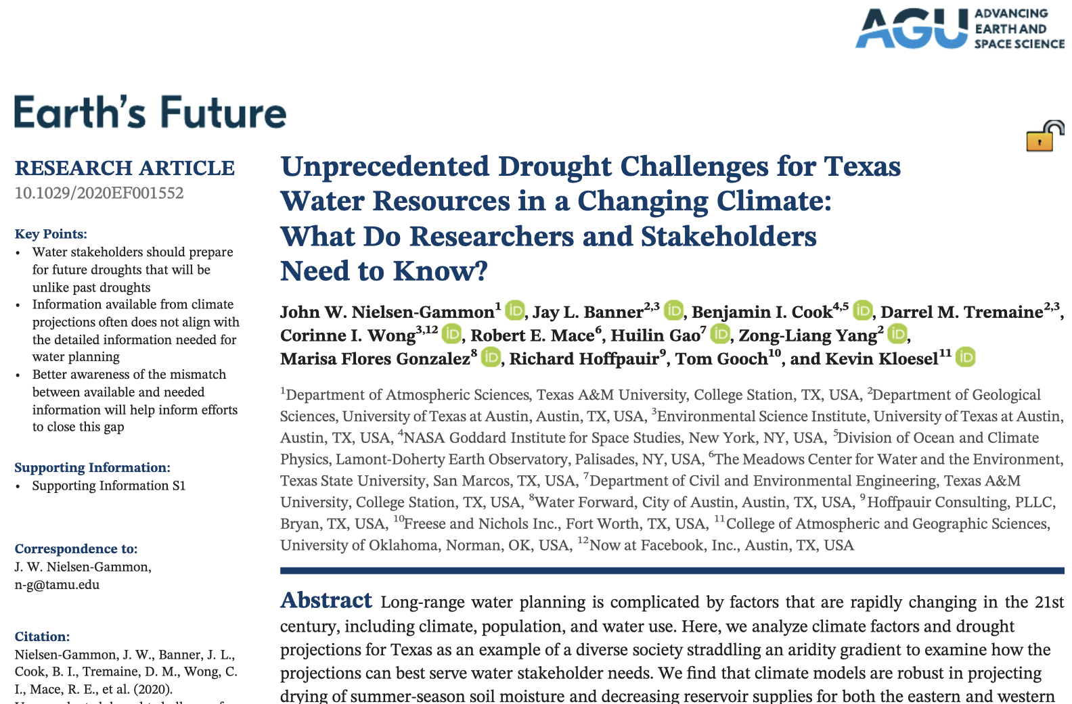
Supported by: The National Science Foundation Coupled Natural and Human Systems program, grant number AGS-1518541, the Cynthia and George Mitchell Foundation grant number G-1809-55892, and by The University of Texas at Austin’s Planet Texas 2050 Bridging Barriers research initiative.

Slide 13
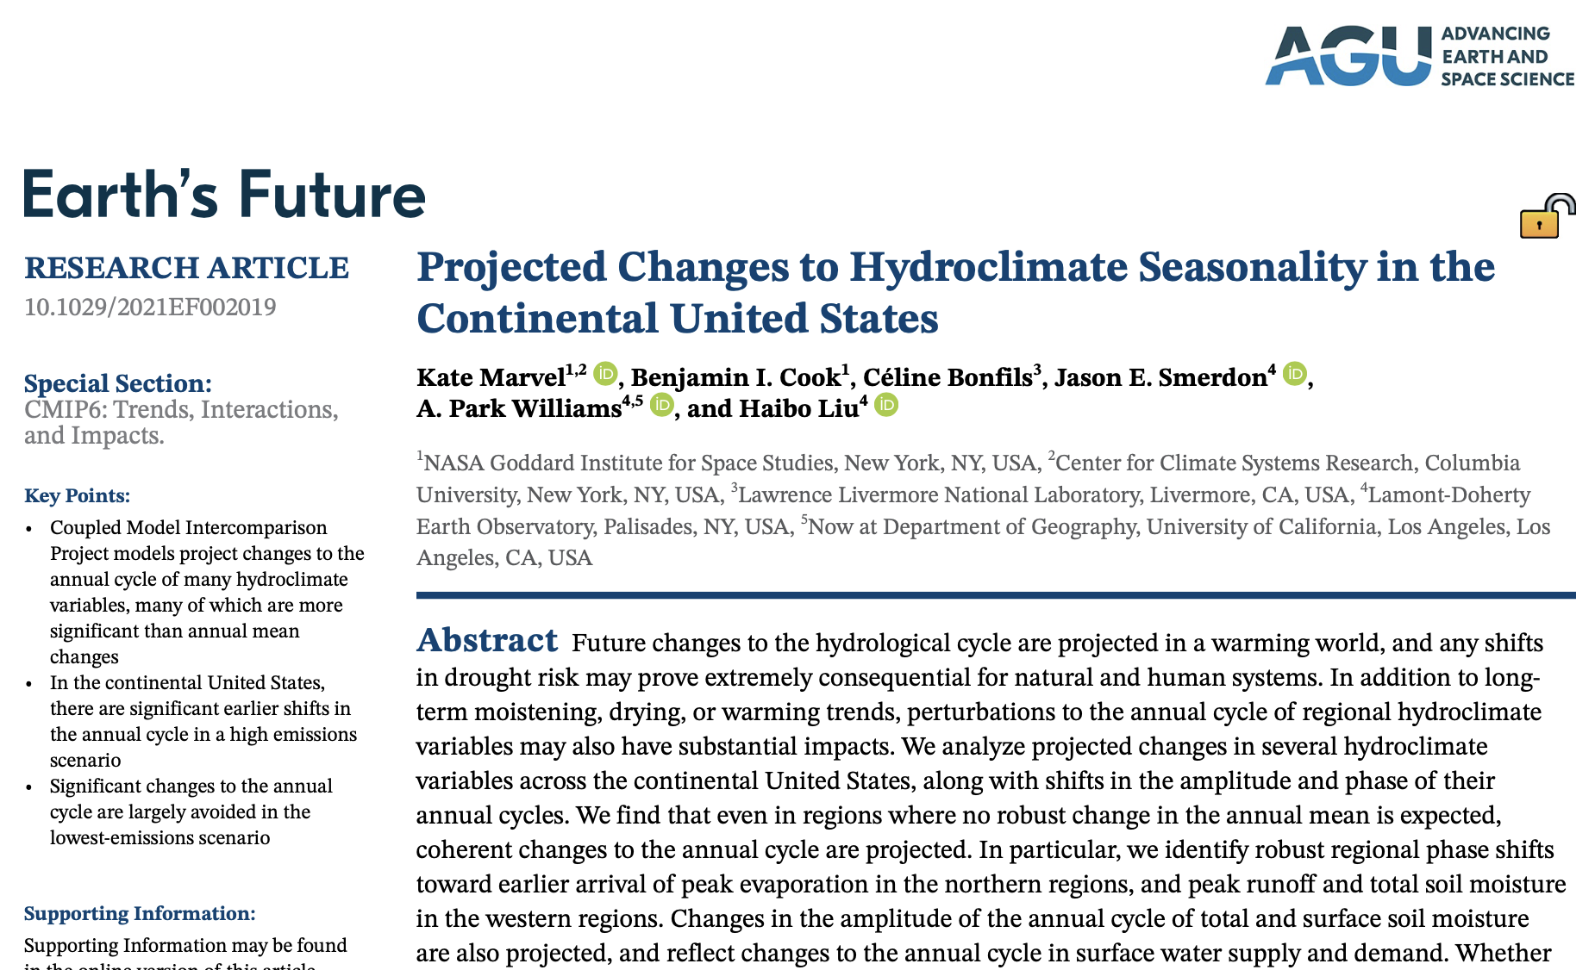

Slide 14
Dryer or wetter?
On the drying side…
  Changes in temperature
  Changes in rainfall extremes, month to month
  Changes in rainfall seasonality
On the wetting side…
  Changes in biosphere water use efficiency
On the unclear side…
  Changes in annual precipitation
  Changes in rainfall extremes, single storms
  Changes in biomass

Slide 15
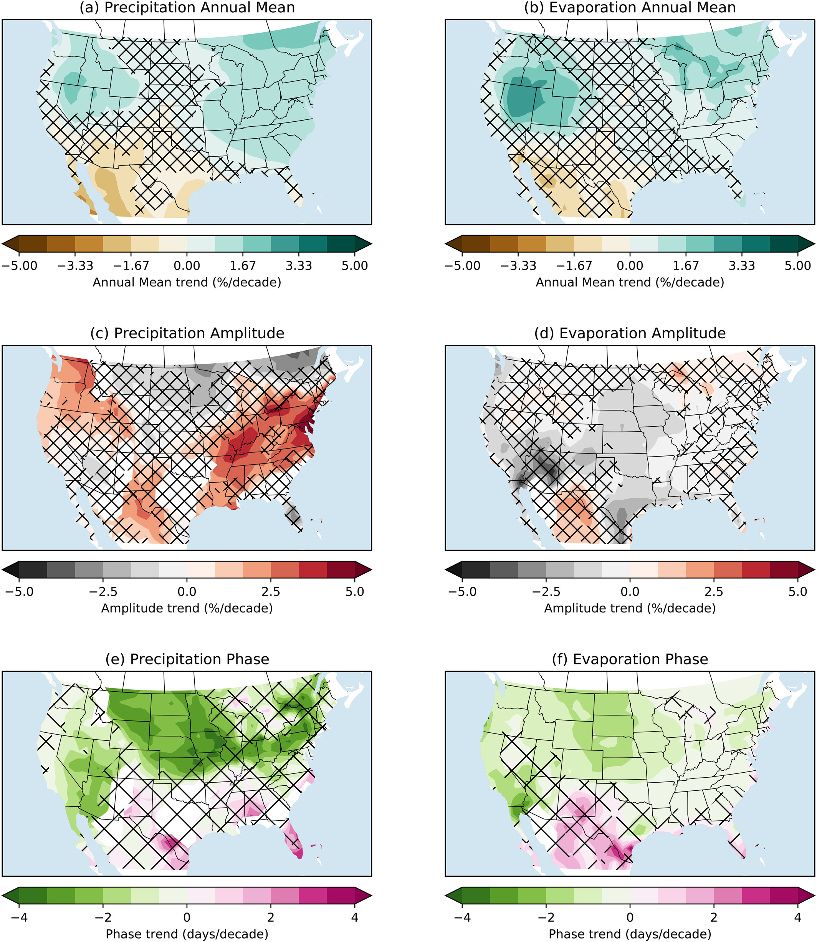

Slide 16
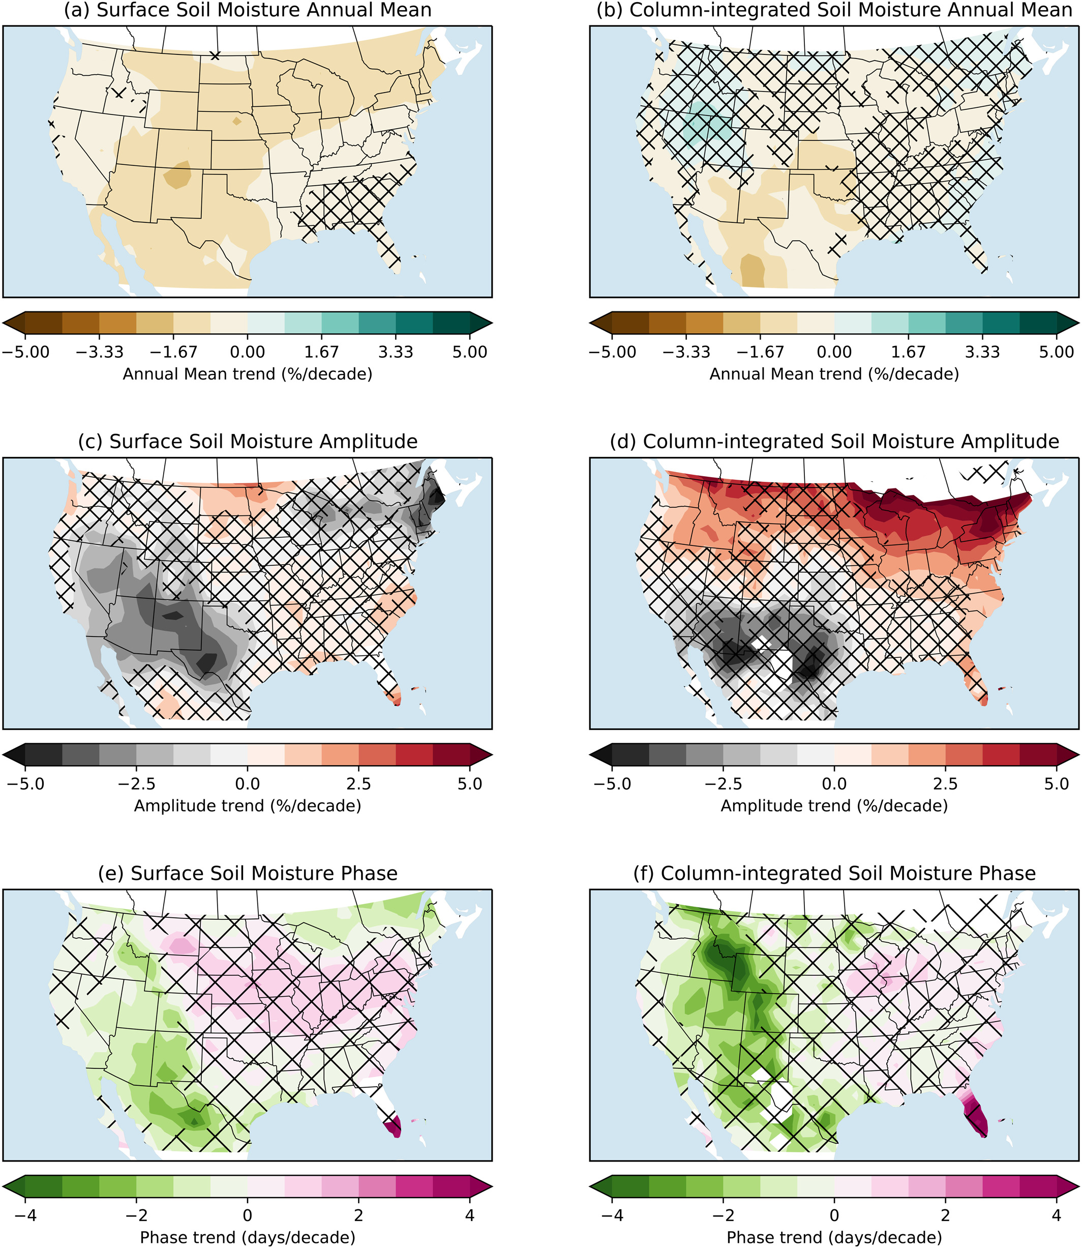

Slide 17
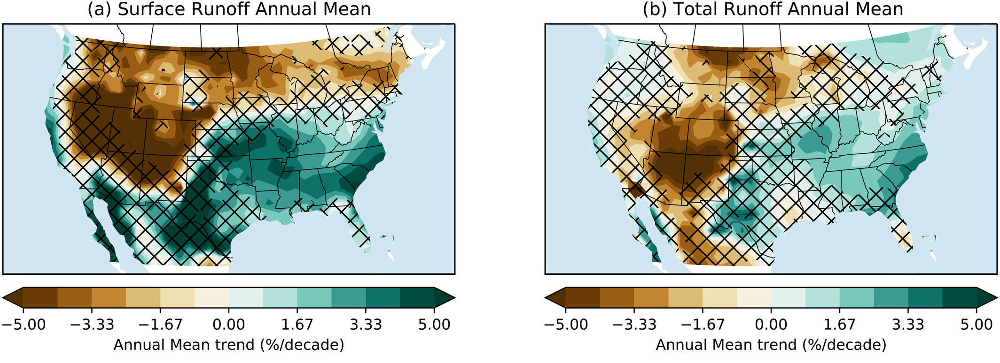

Slide 18
What about really heavy rain?
(research funded by Harris County Flood Control District)
(additional work by Savannah Jorgensen)
(paper to be submitted very soon)

Slide 19
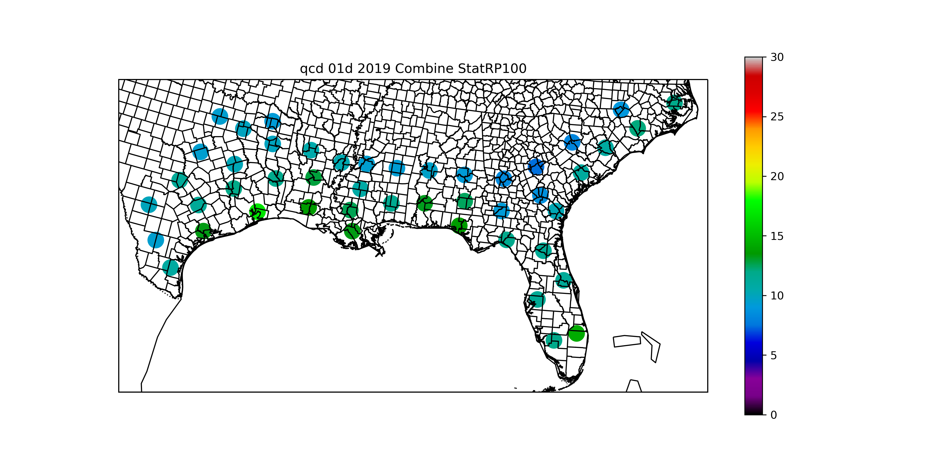
Stationary Return Values (in.)

Slide 20
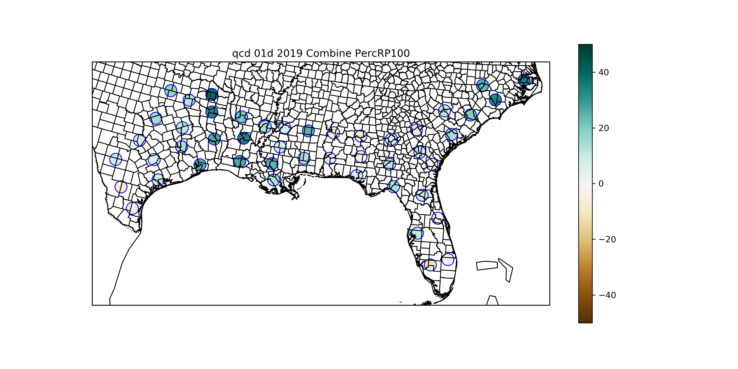
Return Value Trend, 1960-2020 (%)

Slide 21
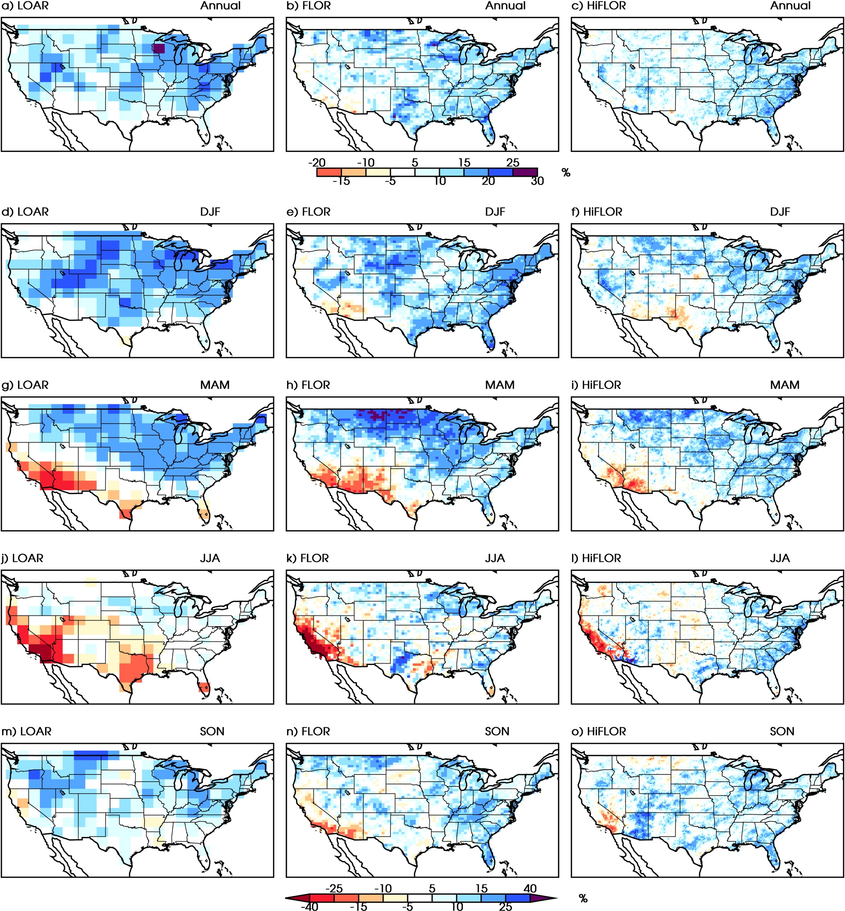
Models predict increases, but…
Van der Weil et al. (2016)

Slide 22
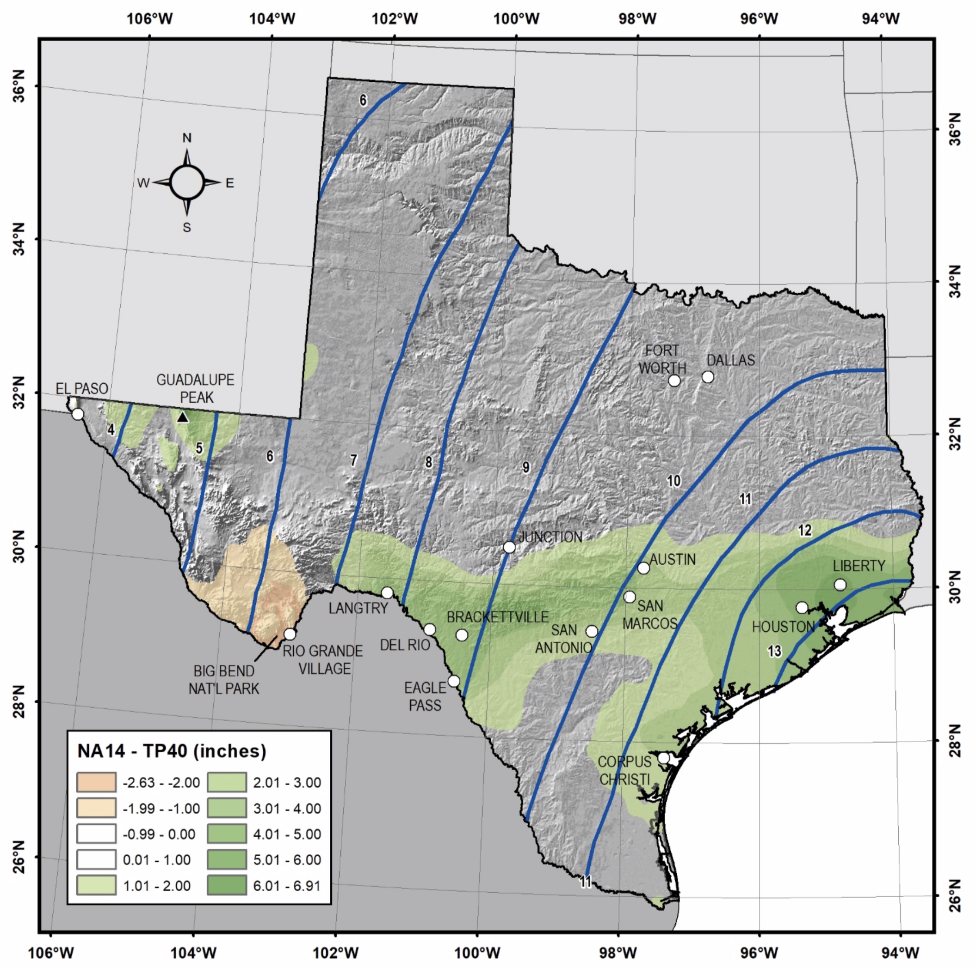
2018: NOAA Atlas 14: Official estimates of extreme rainfall risk (100-yr events, etc.)
Analysis includes 2017 rainfall
Previous analysis dates from 1960s
Old analysis (contours) and change (shading) in 1-day 100-yr rainfall amounts shown at right
8”
6”
4”
10”
New - Old (in.)
12”
2
3
4
5
6
-2
-1
0
1

Slide 23
Lessons
Each type of extreme is different
For some, it is clear
For others, such as drought, it’s complicated
n-g@tamu.edu

Slide 24
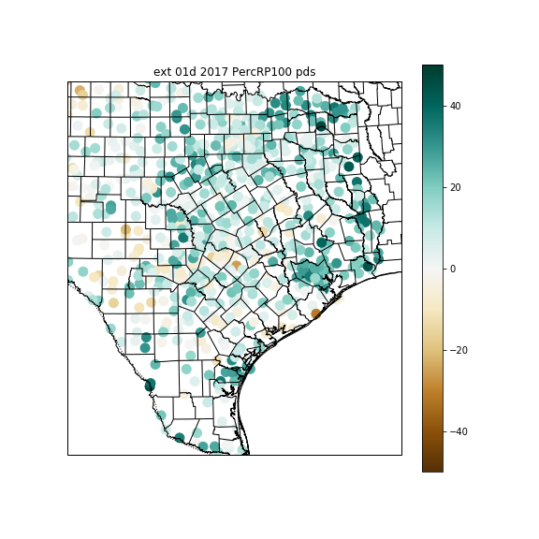
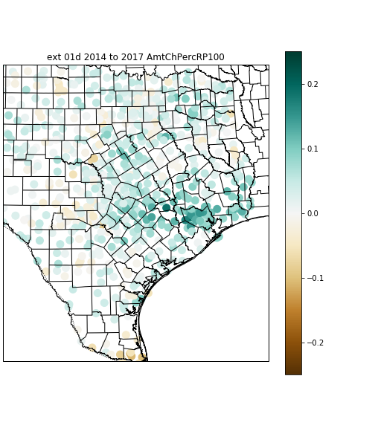
Nonstationary trend (%), 1960-2020
Effect of 2015-2017 events on trend (fraction of return value)

Slide 25
Harris County 1-day
100-yr
Eastern
Central
Western
Atlas 14
Trend to 3.0°C (2100)
Trend to 2.5°C (2070)
Extended records
Trend to 2.0°C (2052)
Trend to 1.5°C (2035)
Larger area
Trend to 2020
1960 baseline
2-yr
Eastern
Central
Western

