Slide 1
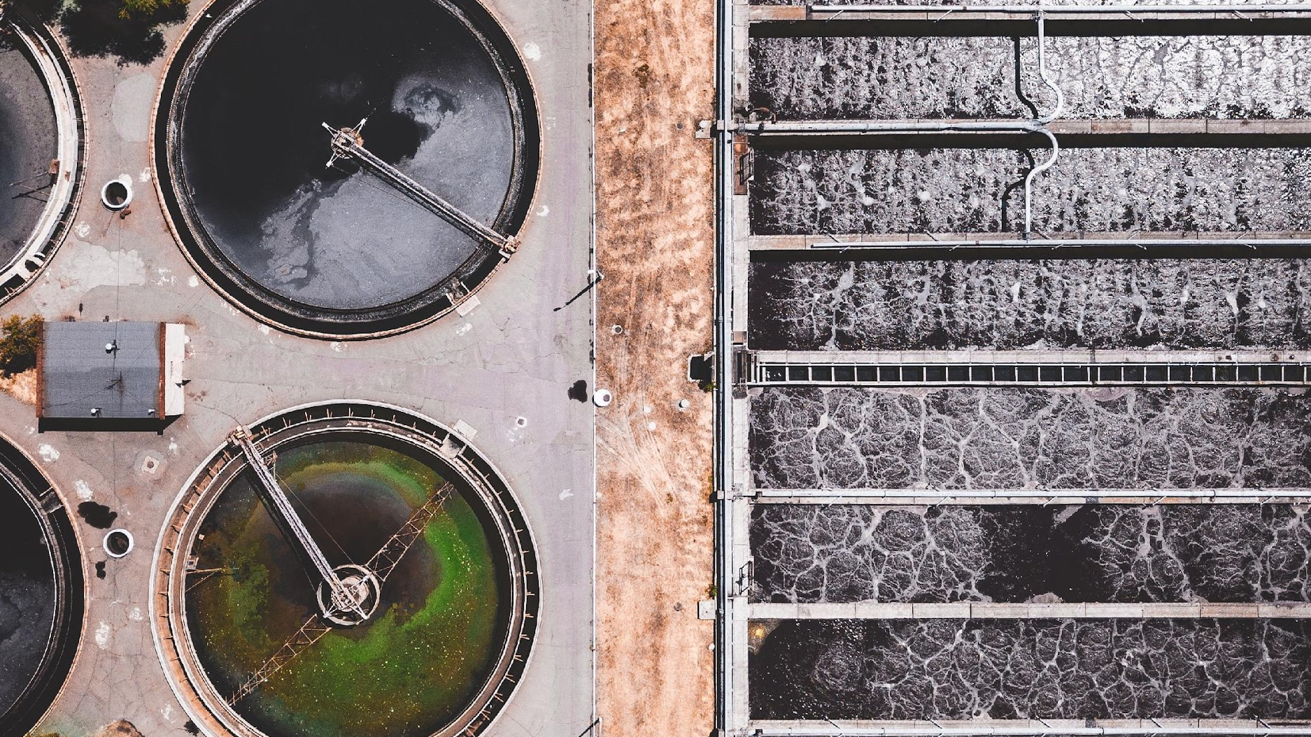



CTWCS
Feb 15, 2022
Funding Opportunities
For Innovative Water Projects
AMANDA FULLER, DIRECTOR
TEXAS COAST AND WATER PROGRAM
NATIONAL WILDLIFE FEDERATION

Slide 2

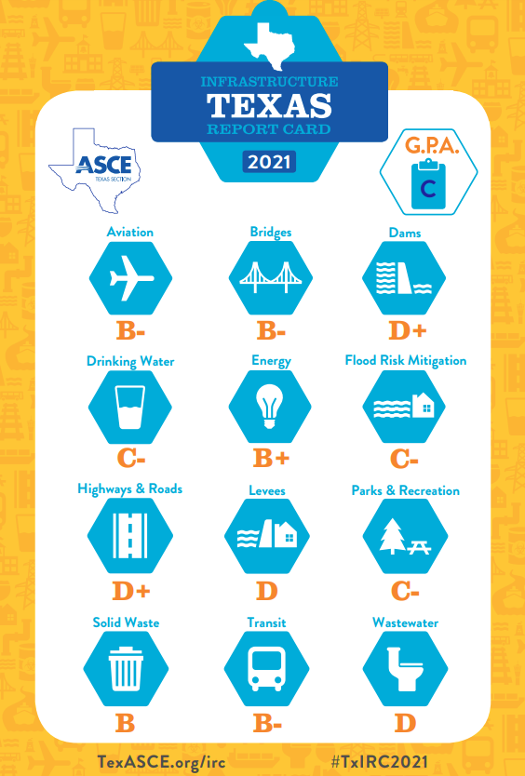
The State Of Water Infrastructure In Texas

Slide 3
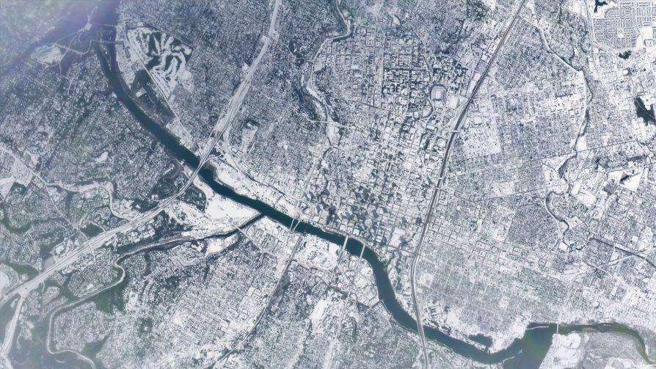
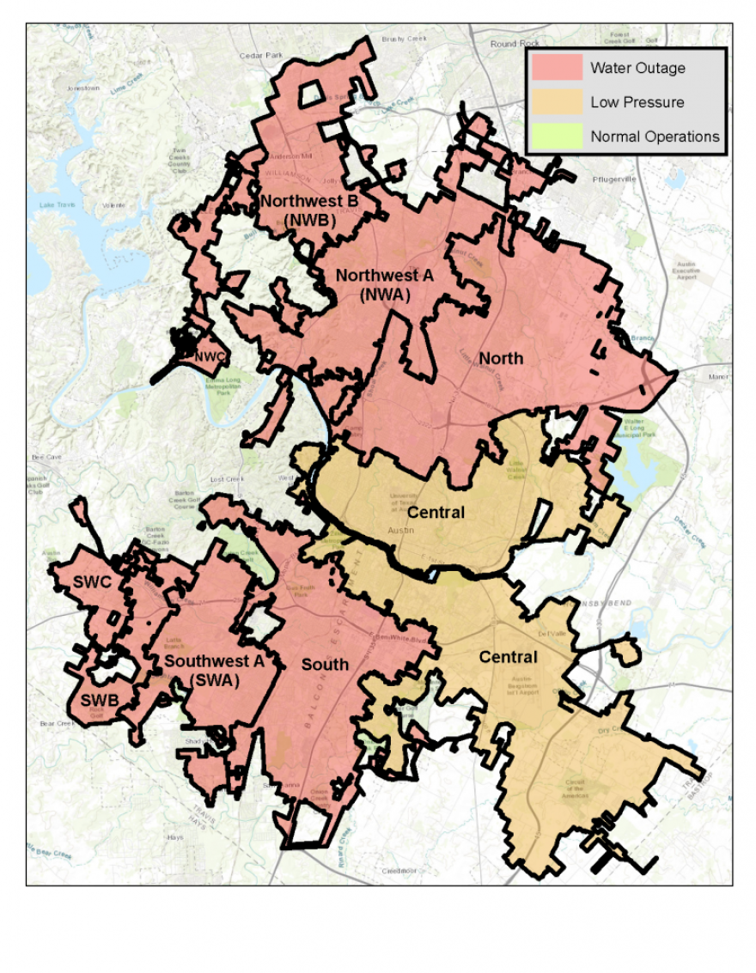

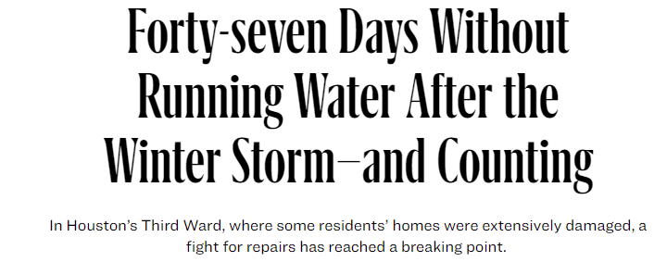
Impact of Winter Storm Uri

Slide 4

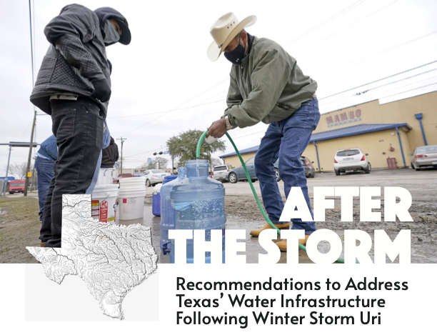

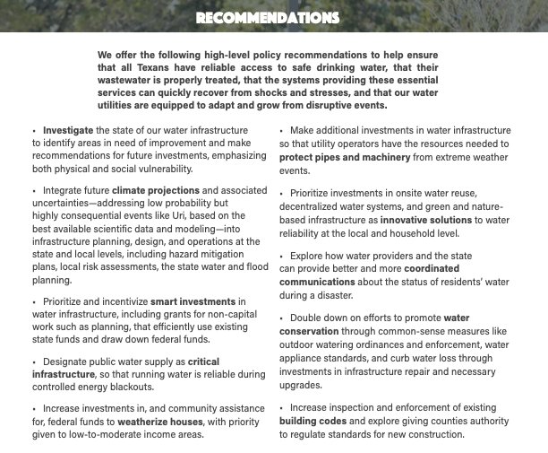



Policy Recommendations

Slide 5
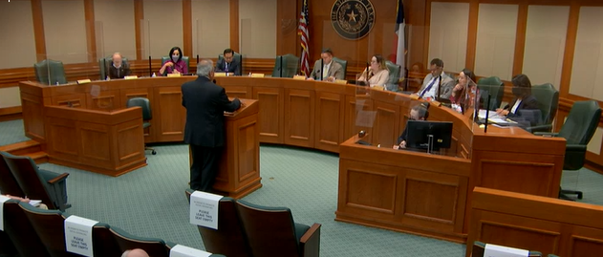
Legislative Response to Water after Uri

Slide 6
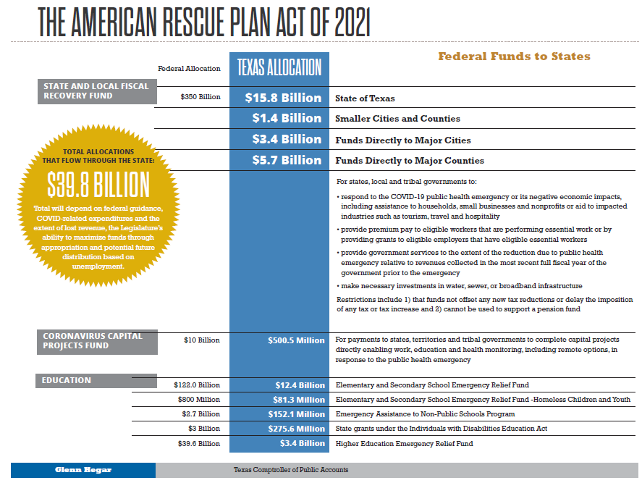
The ARPA Opportunity

Slide 7
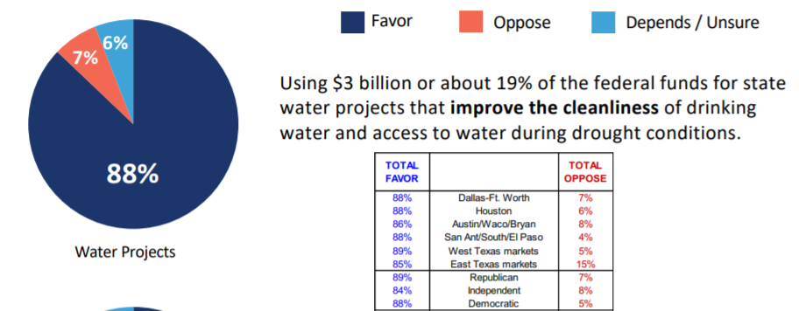
The ARPA Opportunity
Texas 2036 ARPA polling

Slide 8
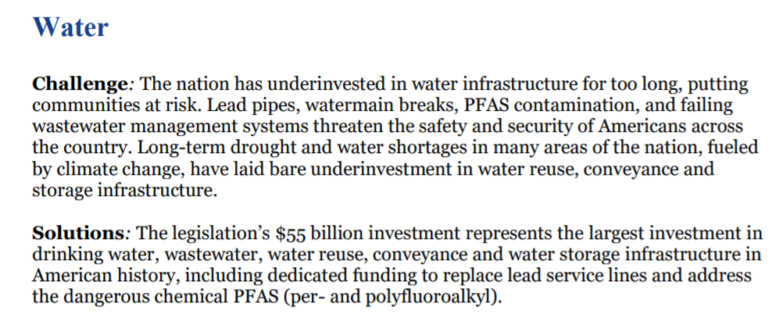
Infrastructure Investment and Jobs Act
“Federal Infrastructure Bill”

Slide 9
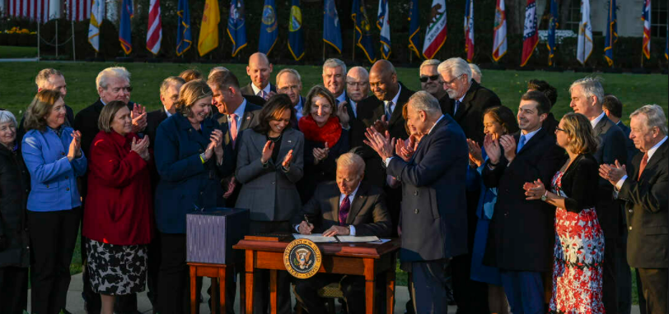
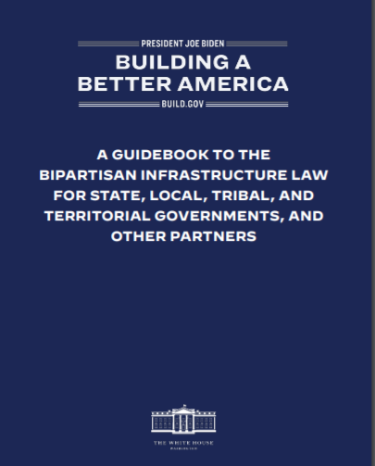
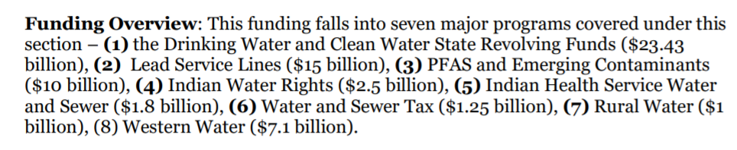
Federal Infrastructure Bill

Slide 10
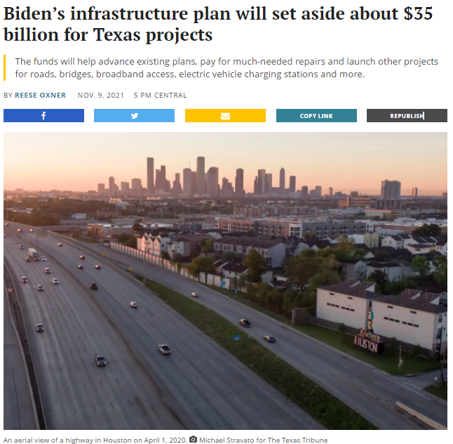
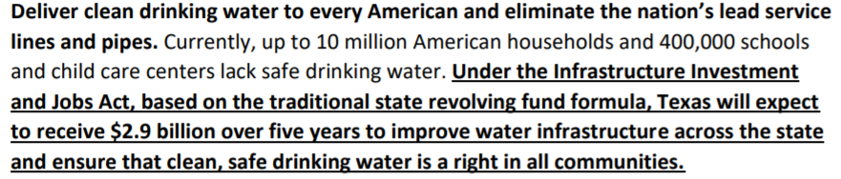
Federal Infrastructure Bill
White House:

Slide 11

Thinking Broadly – Climate Mitigation and Resilience Programs
FEMA’s Building Resilient Infrastructure and Communities (BRIC)
Not dependent on annual Congressional appropriations
FY2020 with $500M 🡪 flood control and utility/infrastructure protection
Biden added $1B in 2021
Next NOFO Aug/Sept and due in Jan 2023
Community Lifelines
Green and natural infrastructure aid in climate mitigation and disaster preparedness

Slide 12
Community Resilience and Green Infrastructure
HUD
FEMA
Opens up a world of funding sources!
Water quality
Economic and community development
Underserved and rural areas
Disaster recovery and mitigation
Transportation (stormwater)
Conservation/ecosystem restoration
BoR
EPA
State Agencies
DOT
USDA
Legal Settlements

Slide 13
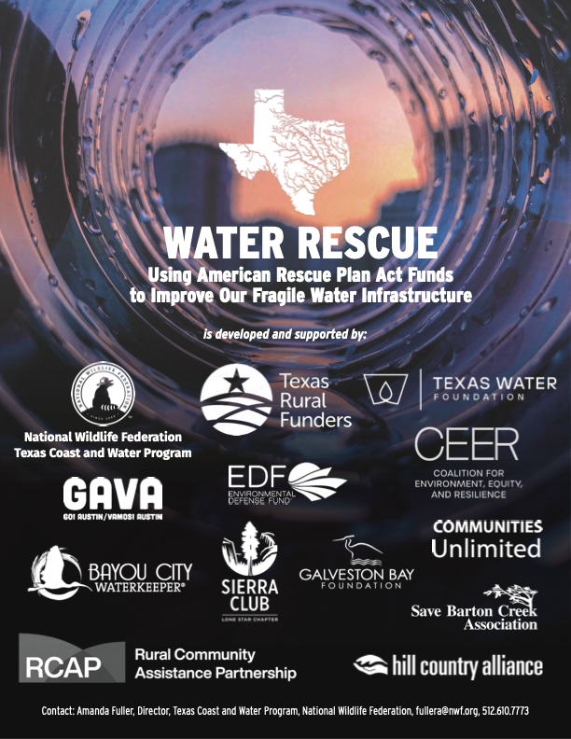
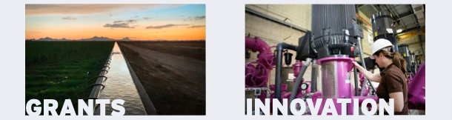
Priorities

Slide 14
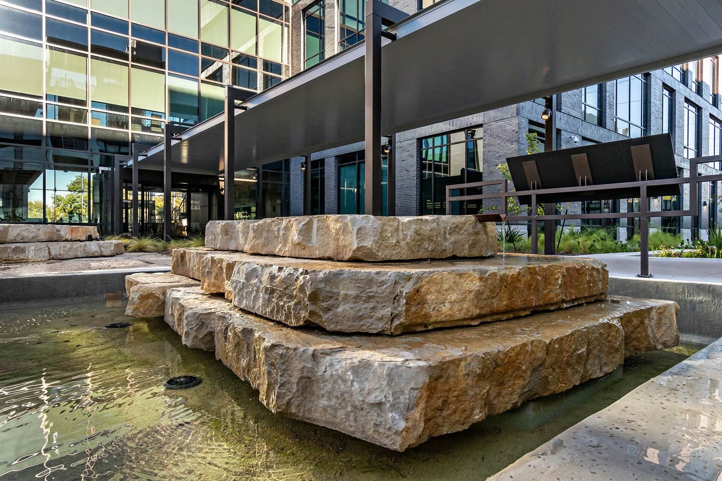
Summary
Federal infrastructure dollars are a significant opportunity 🡪 PIFs due to TWDB by March 4
Think broadly – climate resilience and community lifeline framing
Emphasize innovative solutions like green and nature-based infrastructure
Engage the community
Lean on NGOs
City of Austin’s Permitting and Development Center

Slide 15
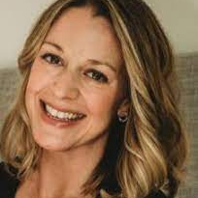
Thank You
AMANDA FULLER
DIRECTOR, TEXAS COAST AND WATER PROGRAM
NATIONAL WILDLIFE FEDERATION
EMAIL: FULLERA@NWF.ORG
PHONE: 512.610.7773

